Slide 1

Final Year Project Final Presentation
Robotic Agnostic Fleet Manager Optimizer:
Fleet Management Connectivity and Map Merging
Student Name: Lau Ler Young Ryan (A0183860Y)
Internal Supervisor: Prof. Marcelo H. Ang Jr.
Internal Co-supervisor: Assoc. Prof. Chen Chao Yu Peter
External Supervisor: Walter Frank Pintor Ortiz
Notes:
Good morning Prof. Marcelo, Assistant Prof Song, Dr. Gallo and DJ. My name is Lau Ler Young Ryan, and this is my final presentation for the final year project. The project title is Robotic agnostic fleet manager optimizer: Fleet management connectivity and map merging.

Slide 2
Content Scope
Project Background
Project Deliverables
(1) Proposed Architecture, (2) Product Creation, (3) Product Testing, (4) Product Conclusion
(1) Replicating Functionalities, (2) Evaluation Testing, (3) Proposed Solution, (4) Product
Testing, (5) Product Conclusion
Project Conclusion
Communication Bridge
Map Merging Tool
Notes:
Here is the scope for todays presentation. The overall flow starts with the project background (Click) to understand the situation and what drives the objectives for the delievrables, this is followed by the presentation of the project deliverables, and then the overall conclusion for this project. For the deliverables, two items of interest and the respective steps taken will be presented.

Slide 3
Project Background
Notes:
Let’s start off with the project background to understand the basis upon which this project was created

Slide 4
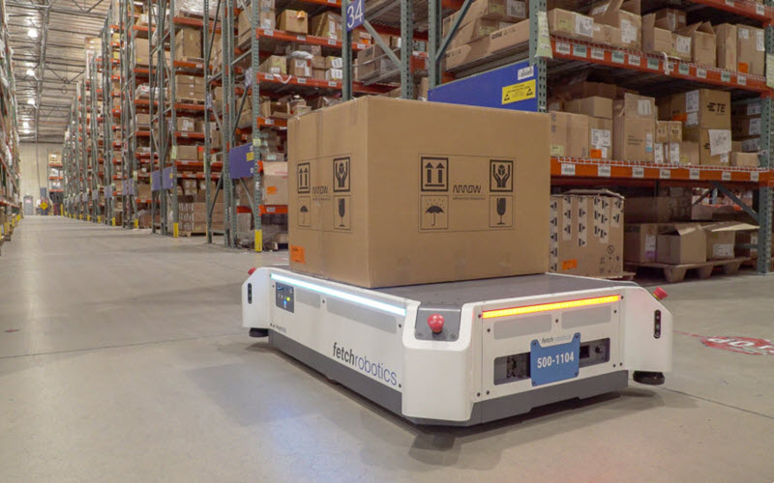
Background
Trend in warehouse automation:
Retail e-commerce boom drives the growth
Challenges in solution adoption:
Limits in a diversified robotic solution
Different communication protocols
Figure 1. Photograph of an autonomous ground vehicle (AGV) from Fetch Robotics
Reference
"Warehouse Automation Market", logisticsIQ, 2022. [Online]. Available: https://www.thelogisticsiq.com/research/warehouse-automation-market/. [Accessed: 13- Jan- 2022].
Notes:
Automation of warehouses is becoming increasingly popular recently due to technological advances as well as a shift in the consumer market with e-commerce leading the way. The benefits that automation brings about include fast, safe and error-free distribution, shorter time to market and ultimately lower costs to businesses and consumers.
When warehouses become increasingly automated, warehouse owners will need to invest in robots to carry out specific need such as santising an area or carrying out patrolling duties, and this diversifies the robot fleet that is to be engaged. However, different robot from different vendors will have different forms of communication which makes it challenging to adopt such a solution.

Slide 5
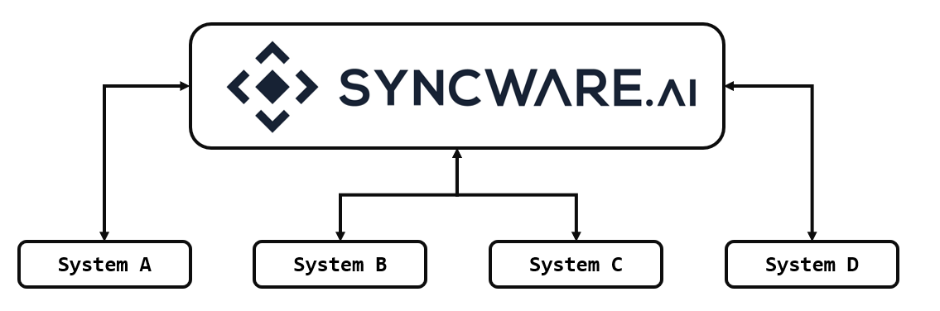
Background
Syncware Pte Ltd’s goal:
Overcome communication incompatibility by providing a common platform
Figure 2. Generic schematic diagram of Syncware’s role in bridging communication between systems.
Reference
"Syncware.ai - Middleware software for warehouse robotics", Syncware.ai, 2022. [Online]. Available: https://www.syncware.ai/. [Accessed: 06- Jan- 2022].
Notes:
With that, Synware, the company that I am attached to for this FYP, is aiming to bridge this gap in communication by providing a common platform to overcome the communication incompatibility barrier. Referring to the figure on the right, the general idea that any kind of system can connect to the platform regardless of the protocol used, and as such, one system can communicate with another system smoothly.

Slide 6
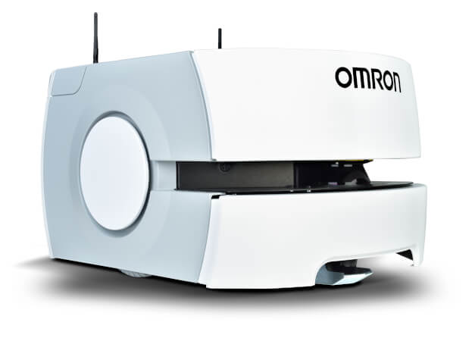
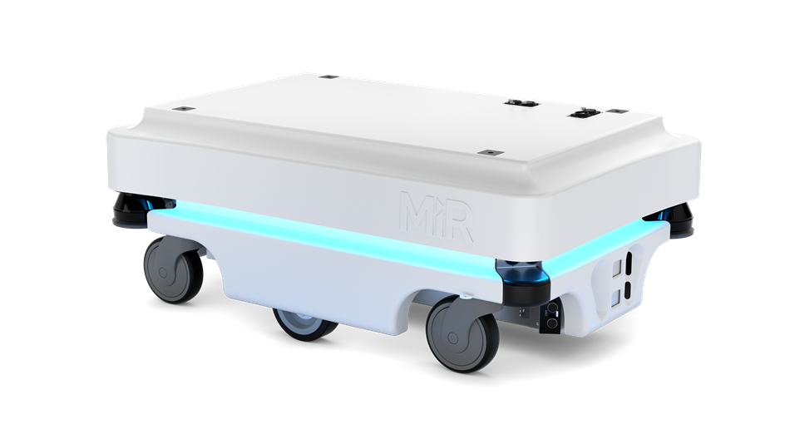


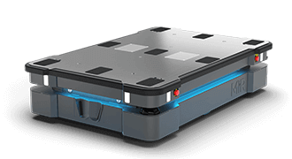

Background
Hybrid Robotic System
Different Communication Protocols
★ Support Required
Communication Bridge
Notes:
Eventually, when multiple different robots are brought together, the presence of different communication protocols will need some support requirements. In this aspect, communication bridges that are key to bridging the communication gap to operate different kinds of robots as a whole.

Slide 7

Background
Syncware Platform
Syncware Fleet Manager
Communication Bridge
Communication Bridge
Robot 1
Robot 2
Robot 3
Robot 4
Robot 5
Robot 6
Robot Vendor A
Robot Vendor B
Notes:
In bridging this communication gap, Syncware aims to create an optimised fleet manager that is able to operate and orchestrate multiple robots from different vendors. And this starts with the creation of the communication bridge.

Slide 8
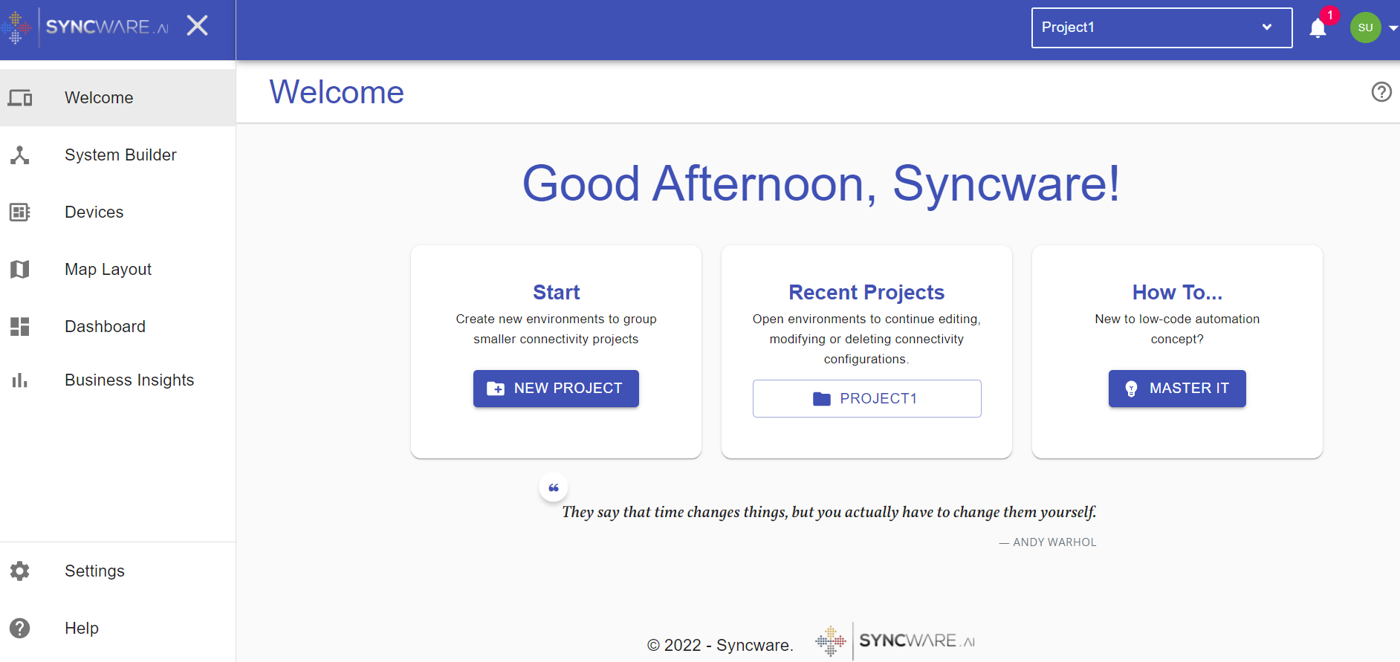
Background
Map Merging Tool
Utilities
Figure 3. Snippet of the home page of the developing Syncware Platform.
Notes:
On the other hand, the Syncware Platform, also coming in the form of a Graphical User Interface (GUI), will also host a bunch of other utilities such as dashboards to help add value to the whole user experience. For this project in addition to the creation of the communication bridge, I was tasked to create a map merging tool.

Slide 9
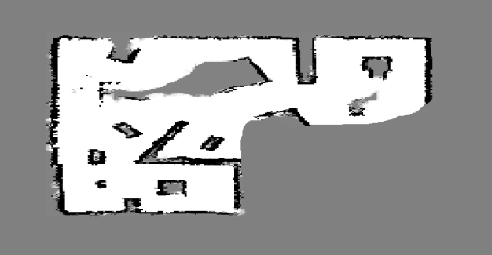
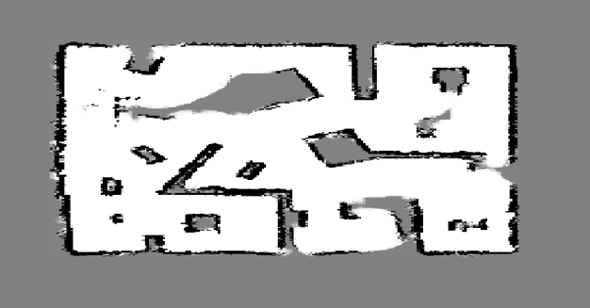
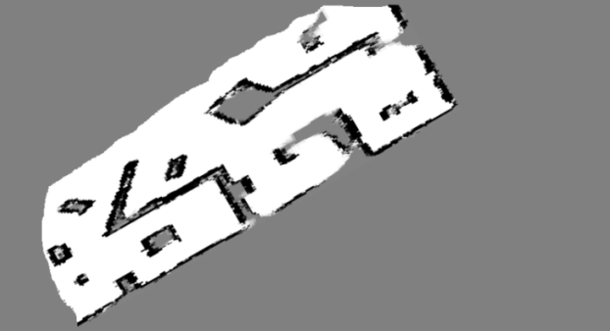
Background
Overlapping Maps
Merged Map
Map Merging Tool
Reference
Sebahattin, Topal & Erkmen, Ismet & Erkmen, Aydan. (2010). A Novel Map Merging Methodology for Multi-Robot Systems. Lecture Notes in Engineering and Computer Science. 2186.
Notes:
What a map merging tool does, is that it basically takes multiple overlapping maps and puts them together into a full map. The benefits that this can bring about is that it reduces the amount of time spent on the mapping process. It is more efficient to map a substantially large enclosed environment with a robot fleet which can operate simultaneously than to carry out the mapping with a single robot. Furthermore, this potentially allows for post mapping modifications such as rectifying erroneous areas in the merged map. The user just needs to map out the corresponding area that was of question and carry out the map merging process with the new set of sub-maps. And these are what motivates the creation of the tool

Slide 10
Project Deliverables
Communication Bridge
Map Merging Tool
Notes:
Now, moving on to the main bulk of the presentation, here are the project deliverables, the communication bridge and the map merging tool. And let me start off with the communication bridge (click).

Slide 11
Project Deliverable
Communication Bridge
Proposed Architecture
Product Testing
Product Discussion
Notes:
Here are the sections under the project deliverable of the communication bridge.

Slide 12
1. Proposed Architecture
Communication Bridge
2. Product Creation
Communication Bridge
3. Product Testing
Communication Bridge
4. Product Discussion
Communication Bridge
Notes:
And with reference to the proposed architecture, the communication bridge was to be created.

Slide 13
1. Proposed Architecture
Communication Bridge
External System
Bridge
Syncware
Bridge
To/From
External System
To/From
Syncware
Core
Plugin
Core
Handling communication protocols with the external system
Gather and store information for extraction by plugin
Retrieving information from the plugin
Sending information to external system
Plugin
Extracting information stored in the core for the Syncware platform
Handling conversion of data types from the core for the Syncware platform and vice versa
Retrieving information from the Syncware platform for the core
Notes:
This was what was proposed.
Let’s take a closer look at the architecture of the communication bridge.
The bridge is made up of two components the core and the plugin, each having its own purposes and responsibilities.
The core is responsible for handling communication protocols with the external system, it gathers and stores information for extraction by the plugin, it retrieves information from the plugin and sends it to the external system (it can be commands)
The pl…..
Looking at the responsibilities of both of the components, the main idea was to create a communication bridge that does not need much modifications to be used with different systems. Since the core component is the one that deals with the communication protocol of the external system to be connected to, it is the only component that shd be modified to establish communcations with the external system.

Slide 14
1. Proposed Architecture
Communication Bridge
2. Product Creation
Communication Bridge
3. Product Testing
Communication Bridge
4. Product Discussion
Communication Bridge
Notes:
And with reference to the proposed architecture, the communication bridge was to be created. However, in order to effectively create such a product, an actual external system was needed for in-house testing and creation.

Slide 15
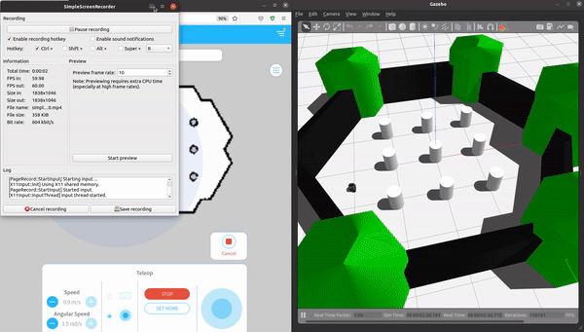
2. Product Creation
Communication Bridge
Collaboration with Movel AI to connect their system to the Syncware platform
The robotic system is called Robot Navigation System (RNS)
Utilises REST API communication protocol
Product: Dual-Component Bridge
Figure 4. (GIF) Demonstration of teleoperation with RNS and Turtlebot3.
Notes:
Fortunately, there was a collaboration with a local robotics solution company, Movel AI, and they wanted to connect one of their systems to Syncware. The purpose of this is so that they would have the capabilities to connect with another external system that uses a different communication protocol. Movel AI’s system is called RNS and it is demonstrated in the GIF on the right. Basically, it is a GUI that makes operating a single robot more user friendly. It is execute mapping, localization, teleoperation and etc. Here we connected it to the Turtlebot3 simulation. The communication protocol utilised by RNS is REST API. Out of this, a communication bridge was created.

Slide 16
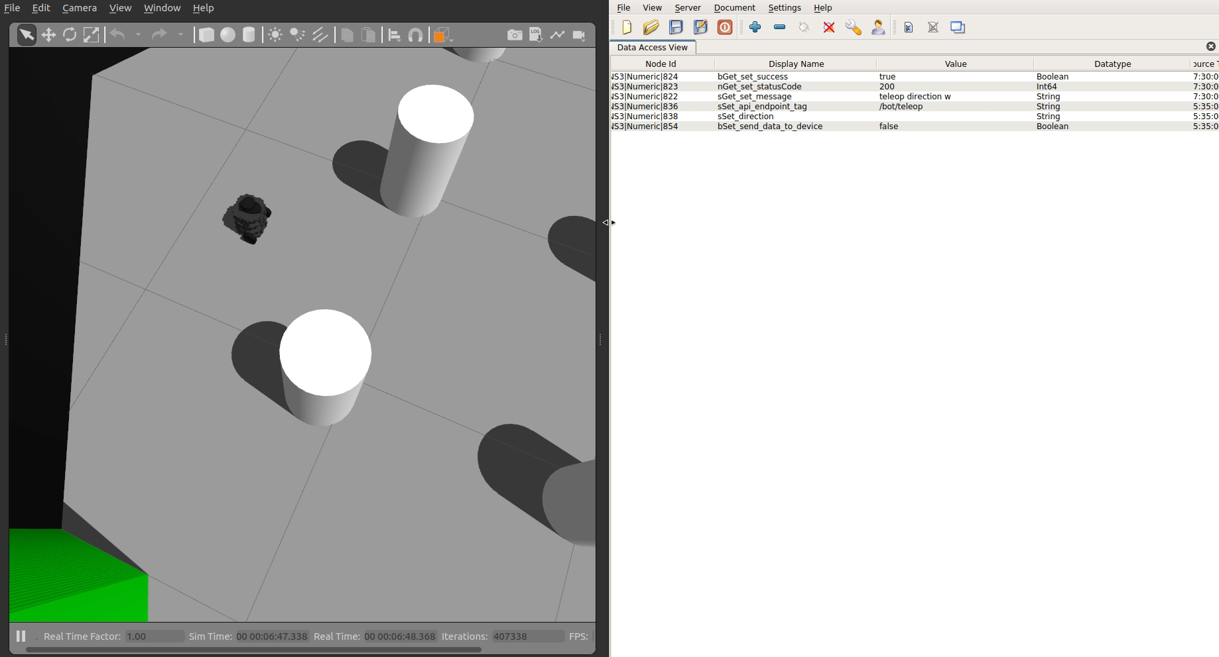
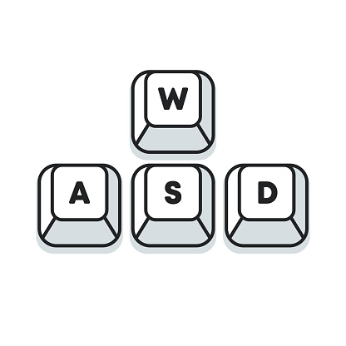
2. Product Creation
Communication Bridge
Turtlebot3 World
Syncware Platform
Message from RNS
Commands sent
Forward
Left
Right
Reverse
Communication Bridge
Turtlebot3 World
RNS
Syncware Platform
Figure 5. (MP4) Demonstration of teleoperation with RNS and Turtlebot3 via communication bridge between Syncware and RNS.
Notes:
The general flow is that the Syncware platform sends information through the communication bridge to SEIRIOS RNS and then it conveys the information to the robot simulation world. Here is a demonstration of the communication bridge in action in the background. The right half represents the synware platform, while the left half represents the turtlebot3 simulation that Movel AI’s tool is connect to.
Here the commands for teleoperation are sent from the Syncware platform to Movel AI’s tool and towards the turtlebot3 simulation world, whereby the teleoperation move is executed. The Syncware platform also receives feedback from the API endpoints as shown by the changing messages received right after the sending of the command.

Slide 17
1. Proposed Architecture
Communication Bridge
2. Product Creation
Communication Bridge
3. Product Testing
Communication Bridge
4. Product Discussion
Communication Bridge
Notes:
With this communication bridge, what needed to be done next was to test it out with another system to proof that it is as robust as it was formulated to be.

Slide 18
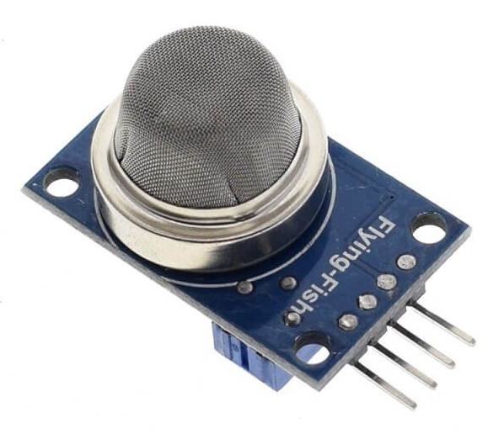
3. Product Testing
Communication Bridge
Collaboration with another entity to connect an air sensor to the Syncware Platform
Visualise data extracted from the air sensor in a dashboard
Utilises Message Queueing Telemetry Transport (MQTT) communication protocol
Communication Bridge
Figure 6. Illustration of connectivity between Syncware and the air sensor via the communication bridge
Notes:
Fortunately Syncware was engaged by another organisation to establish connection with a particular device, which is an air sensor. The goal is to collect and visualise the data collected from multiple sensors for their own research. The data needs to be processed and visualised on the Synware Platform GUI. In addition, this particular device utilises the communication protocol of the MQTT.

Slide 19
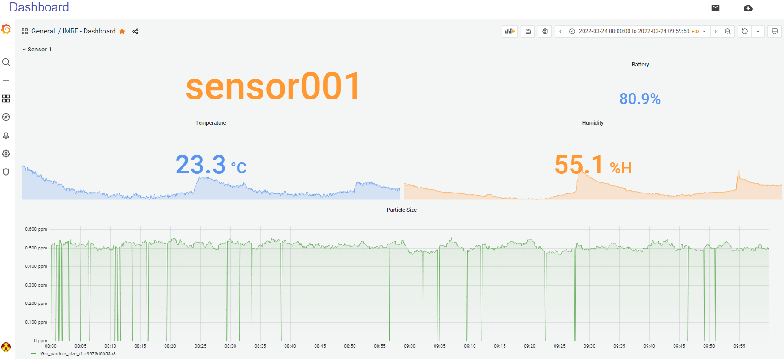
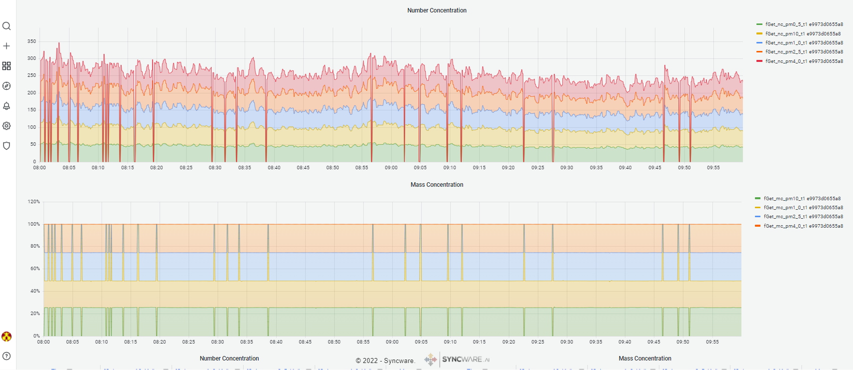
3. Product Testing
Communication Bridge
Modified the core to accommodate MQTT protocol
Plugin component left untouched
Successfully extracted information in real-time
Figure 7. Snippet of dashboard visualizing the information extracted from the sensor as time-series graphs
Notes:
And as such, the core of the communication bridge was modified to accommodate this protocol. The other component was left untouched and information was extracted constantly in real-time. Looking at the figure on the right, we were able to see the movement of time-series graphs in real-time.

Slide 20
1. Proposed Architecture
Communication Bridge
2. Product Creation
Communication Bridge
3. Product Testing
Communication Bridge
4. Product Discussion
Communication Bridge
Notes:
With that here comes the product discussion, to conclude the deliverable of the communication bridge, and to suggest recommended further improvements that can be made to the product.

Slide 21

4. Product Discussion
Communication Bridge
Product Conclusion
A robust architecture was proposed for the communication bridge
Required little modifications when faced with a different communication protocol
Recommended Further Improvements
Creating a many-to-one architecture to reduce usage of computational resources
Modifying to handle multiple communication protocols at once
1 device
1 communication bridge
Figure 8. Illustration one-to-one connectivity architecture
“Select REST API”
Device 1
Device 2
Device 3
1 communication bridge
Bridge
Figure 9. Illustration many-to-one architecture
Figure 10. Illustration selection of protocol instead of modification of code
Notes:
From the proposal stage to the final product testing stage, a communication bridge was formulated and created on the basis of reducing the need for extensive modifications the whole product to accommodate different kinds of communication protocols. The communication bridge comes in the form of two components, the core and the plugin to handle communications with the external system and the Syncware platform separately. The product testing showed that little modifications were required to connect to a different system and thus the main idea was realised.
For further improvements, I would like to suggest creating a many-to-one architecture to reduce the usage of computational resources. Currently, one device is connected to one communication bridge, but in the future, it could be more efficient to have multiple devices connecting to one communication bridge. This also promotes the scalability of the product. On the other hand, the communication bridge needs to handle more communication protocols (currently MQTT and REST API were handled). It would be good to have the core to store methods to handle a variety of protocols, and the user just needs to specify which to be utilised. → this adds on to the whole idea of a plug and play without any intervention

Slide 22
Project Deliverables
Communication Bridge
Map Merging Tool
Notes:
Moving on to the last and final deliverable, that is the map merging tool.

Slide 23
Project Deliverable
Map Merging Tool
Replicating Functionalities
Evaluation Testing
Proposed Solution
Product Testing
Product Discussion
Notes:
And here are the sections

Slide 24
1. Replicating Functionalities
Map Merging Tool
2. Evaluation Testing
Map Merging Tool
3. Proposed Solution
Map Merging Tool
4. Product Testing
Map Merging Tool
5. Product Discussion
Map Merging Tool
Notes:
Starting of with replicating similar functionalities

Slide 25
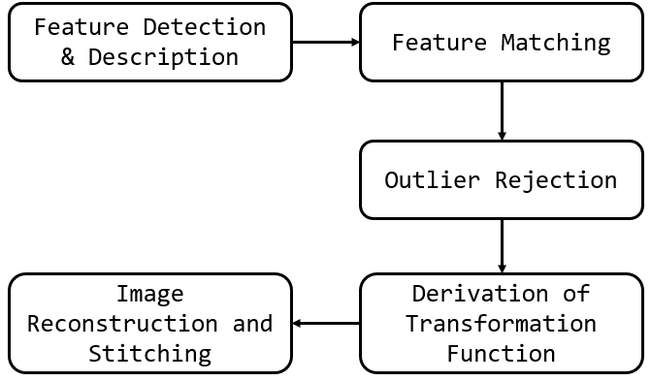
1. Replicating Functionalities
Map Merging Tool
Attempted to recreate the panorama stitching sequence manually
Follows a standard step-by-step process to stitch overlapping images together
Product: Pair-Map Stitcher Class
Reference
A. Rosebrock, "OpenCV panorama stitching - PyImageSearch", PyImageSearch, 2022. [Online]. Available: https://pyimagesearch.com/2016/01/11/opencv-panorama-stitching/. [Accessed: 29- Mar- 2022].
Figure 10. Standard process of image stitching via feature-based methods.
Notes:
The first phase of the map merging part of the project is to replicate similar functionalities, and what was found was that the panorama stitching sequence was suitable and fit for the task at hand. The panorama stitching sequence follows a generic 5 step process to stitch overlapping images together. The steps start by detecting features in the images, matching images across images, rejecting outliers, using the inliers to derive a transformation function, and apply this function to the images so that all exist in the same coordinate frame, causing the alignment and hence stitching of overlapping images.

Slide 26
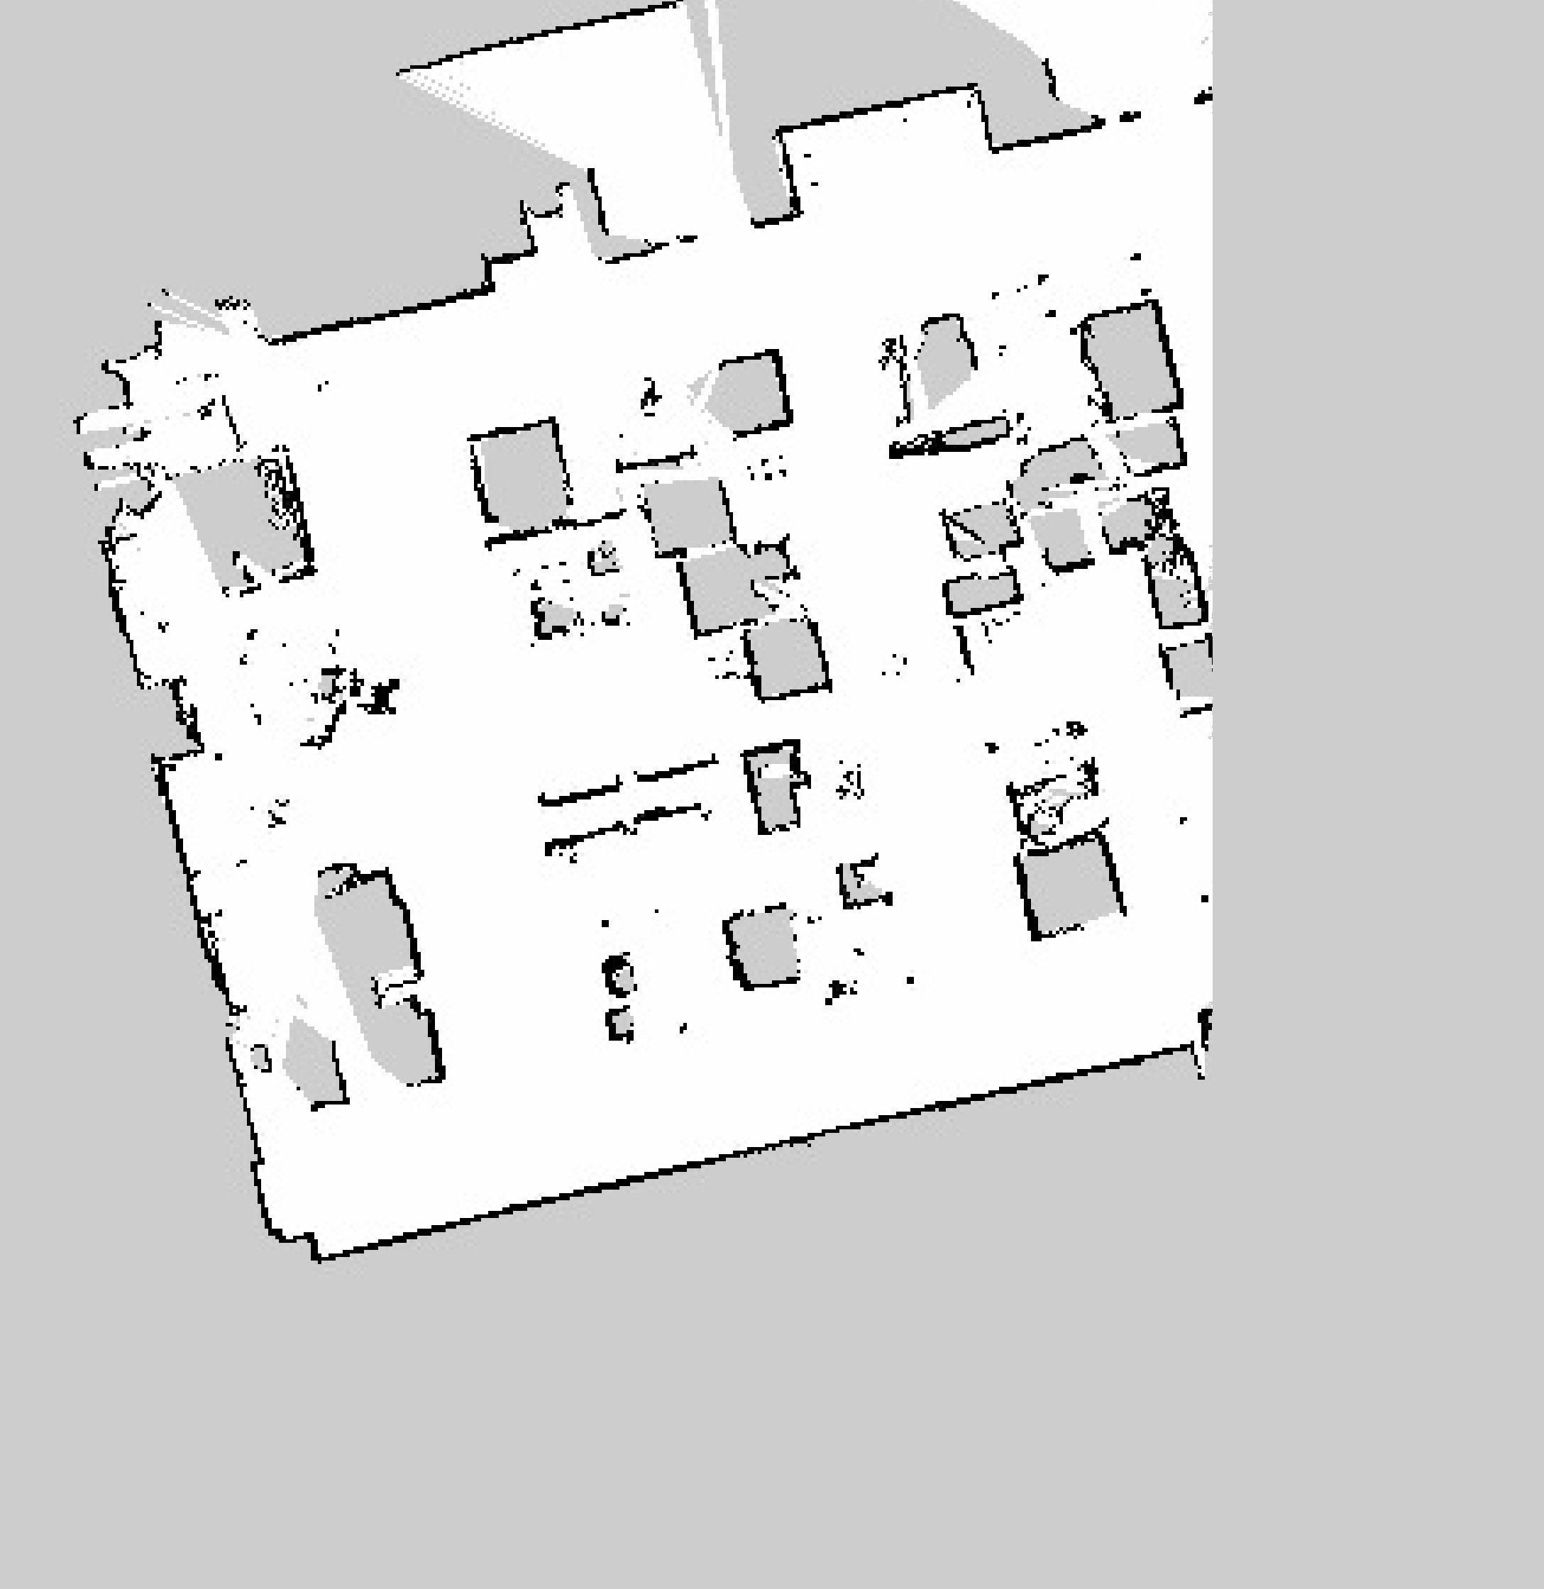
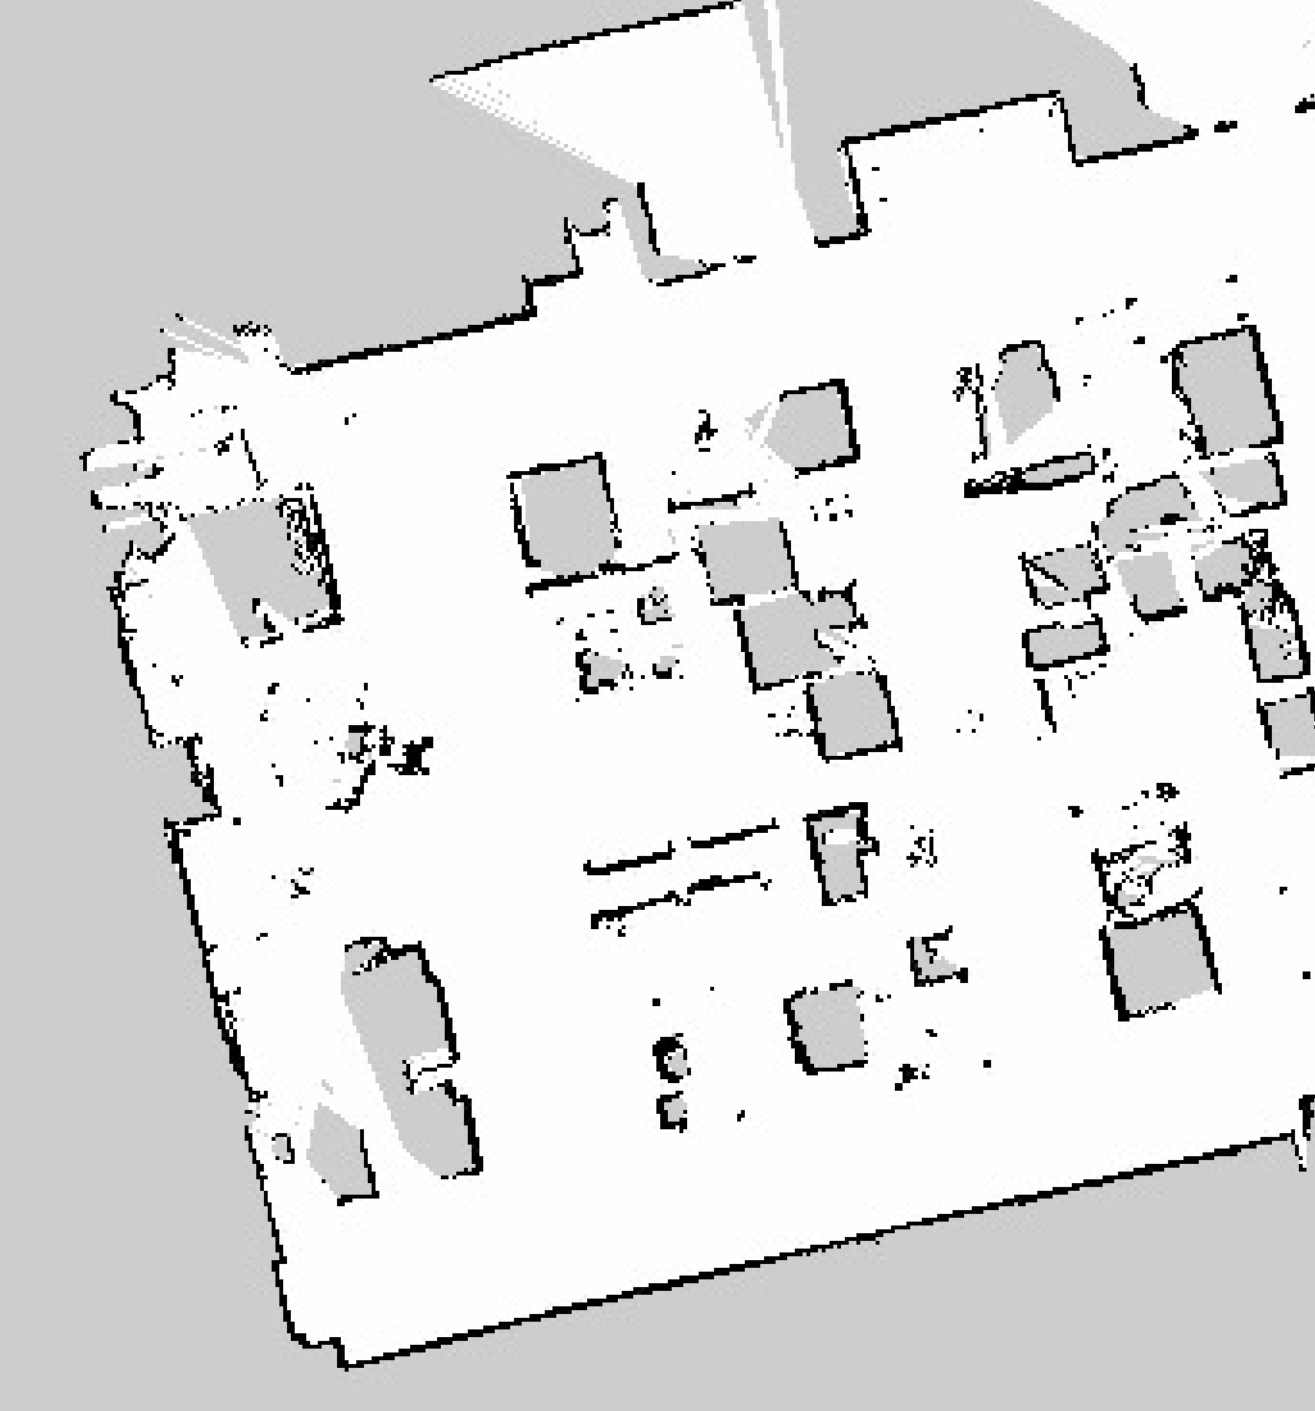
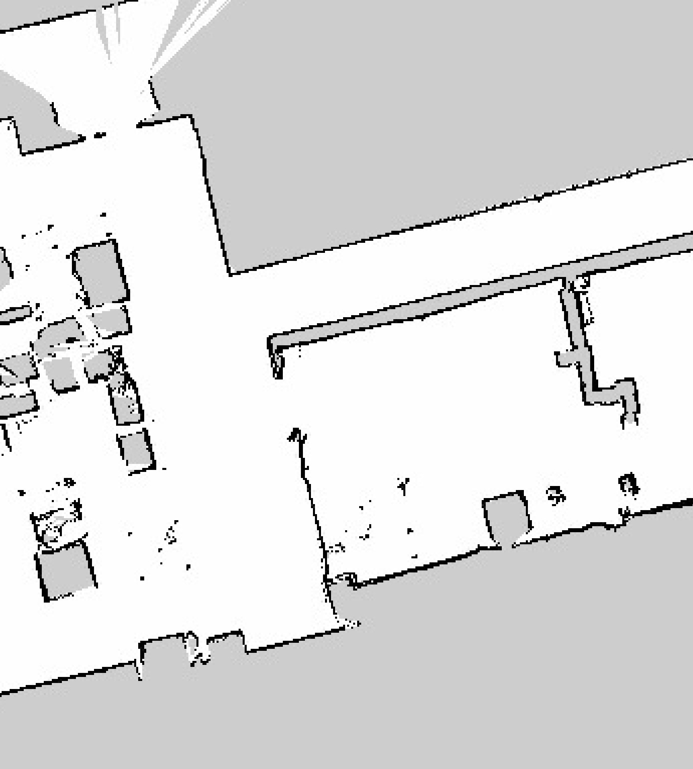
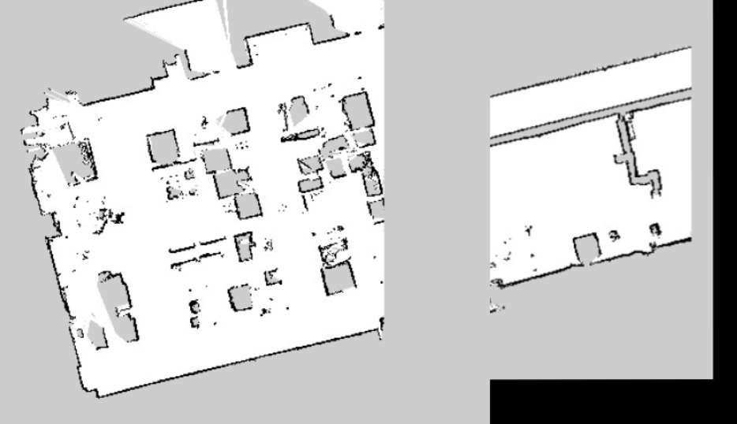
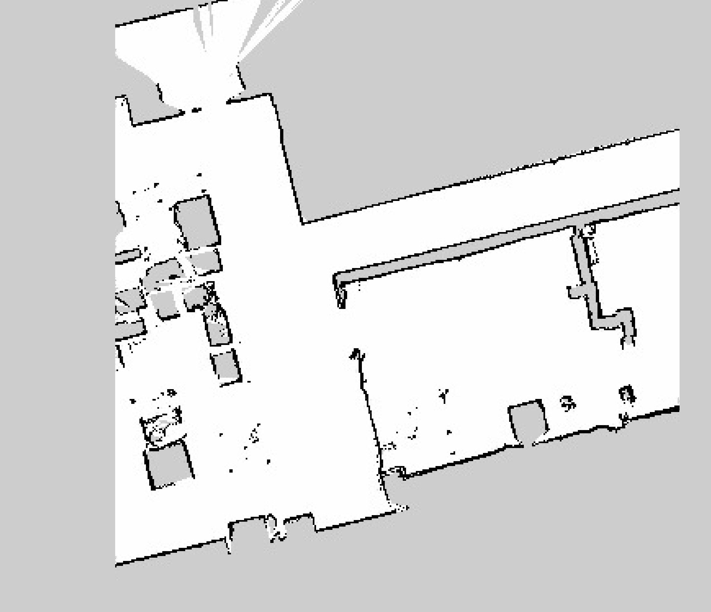
1. Replicating Functionalities
Map Merging Tool
Limitation: Grey padding overlaps maps
Map Merging Tool
Notes:
With this a pair of overlapping maps were supplied to the map merging tool and this was what was produced. There was an obvious area of grey overlap that seemed to be contributed from the extra grey padding in these images. What I found out was that panorama stitching techniques assume that the images supplied are part of a continuous panel of images and transforms each image to literally overlap one another. Here we see that it works without the extra grey padding. But this limitation needs to be solved as maps usually have this feature.

Slide 27
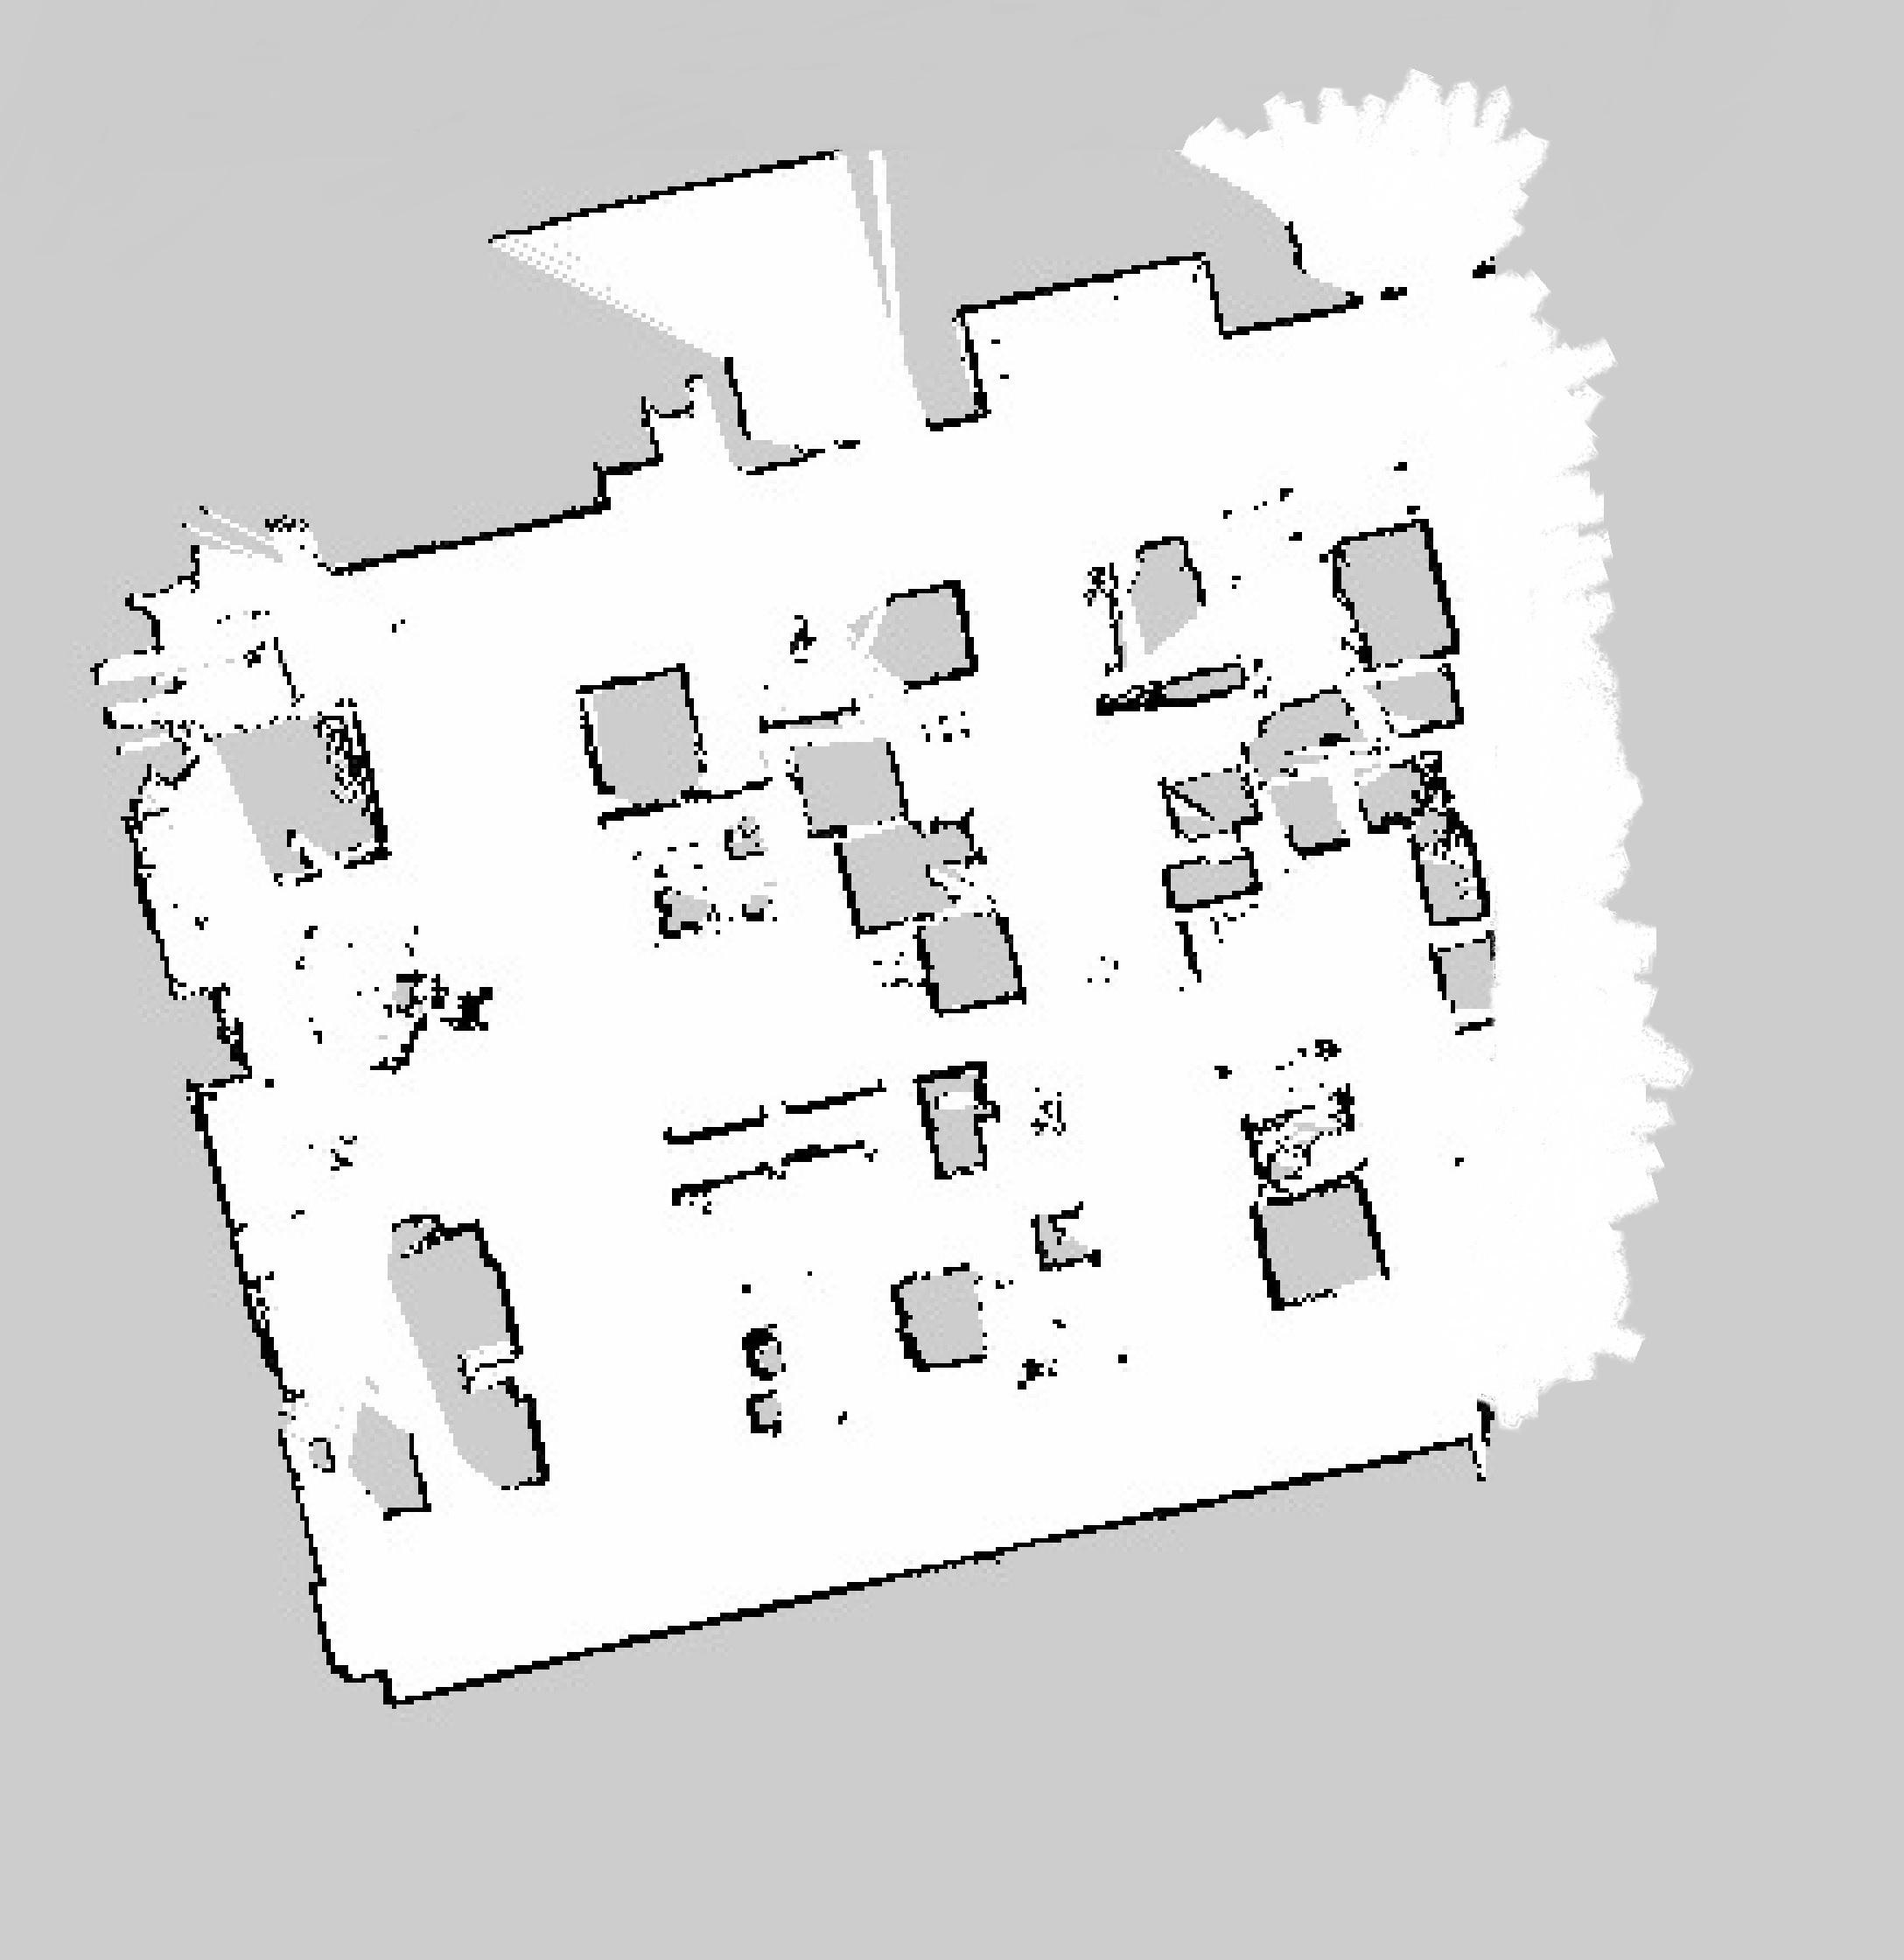
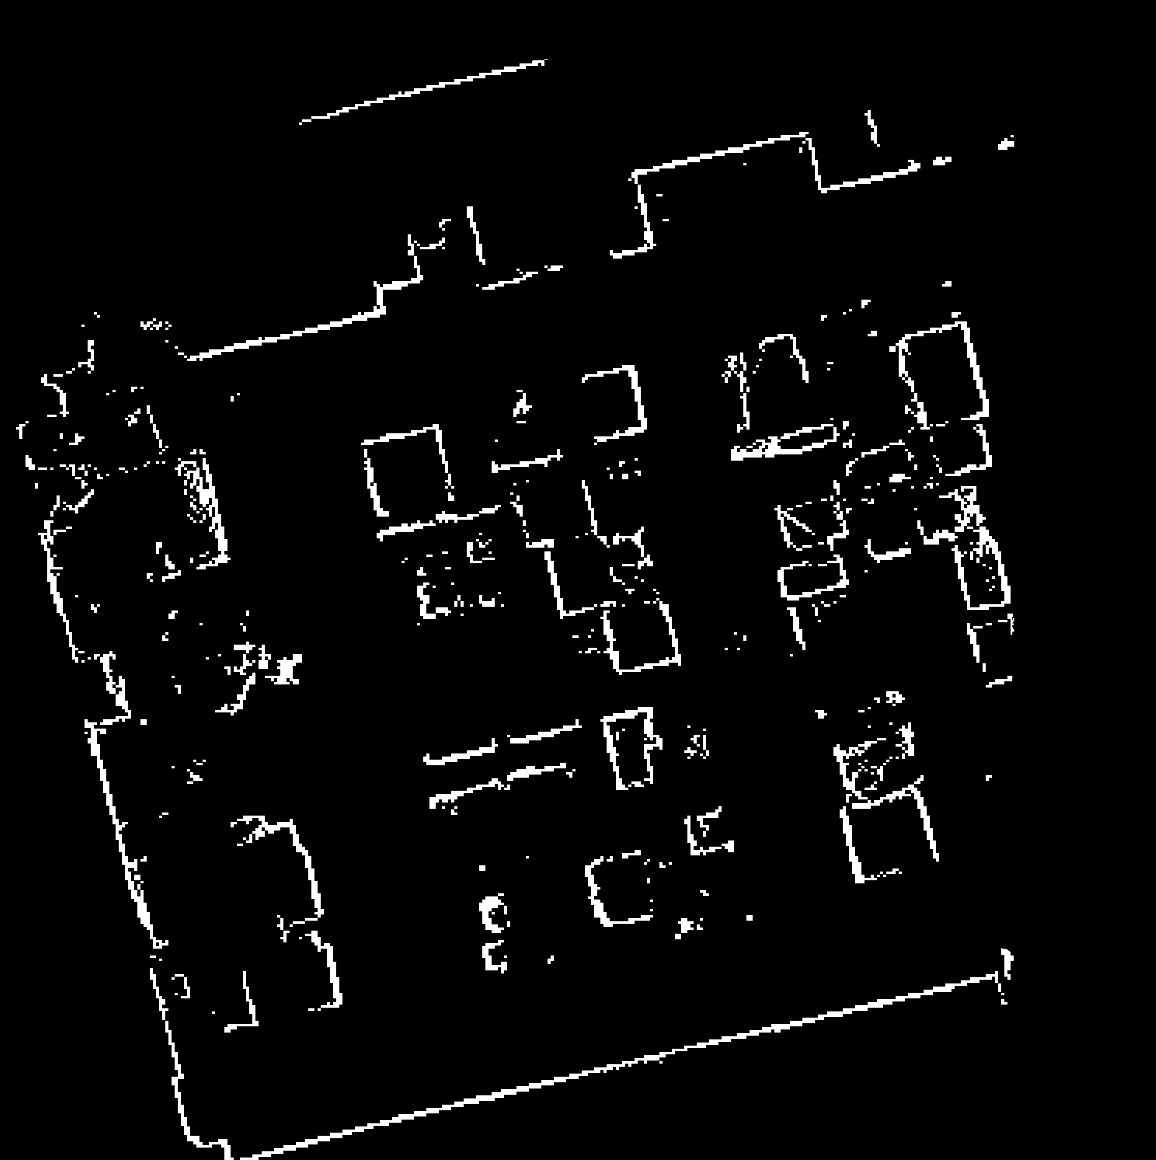
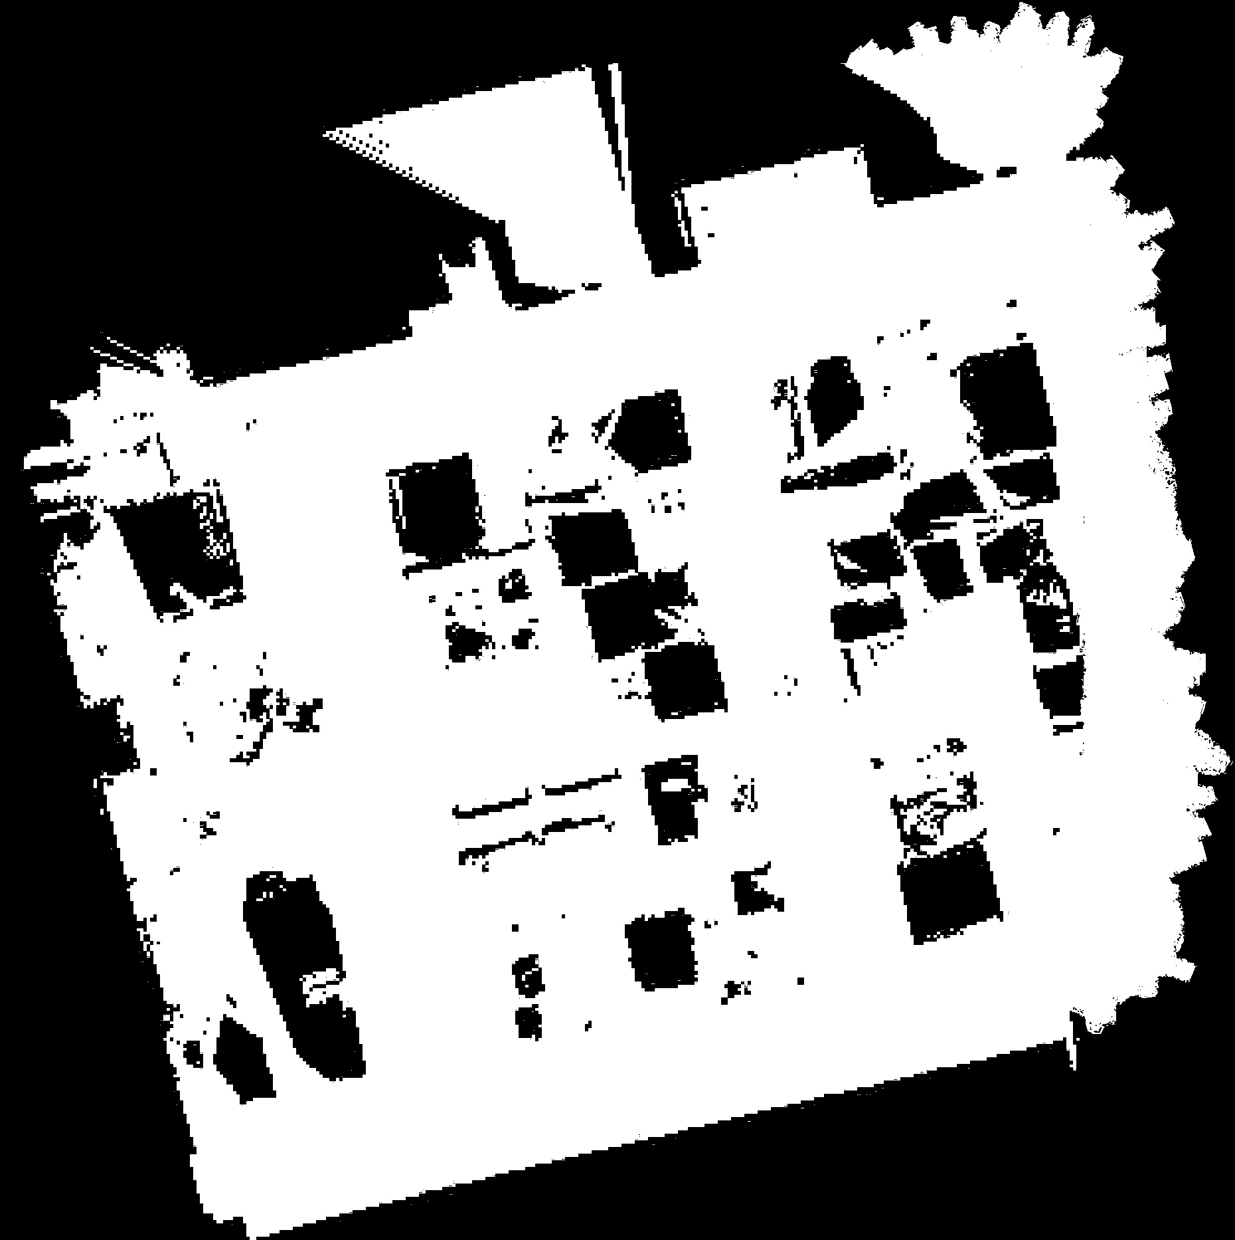
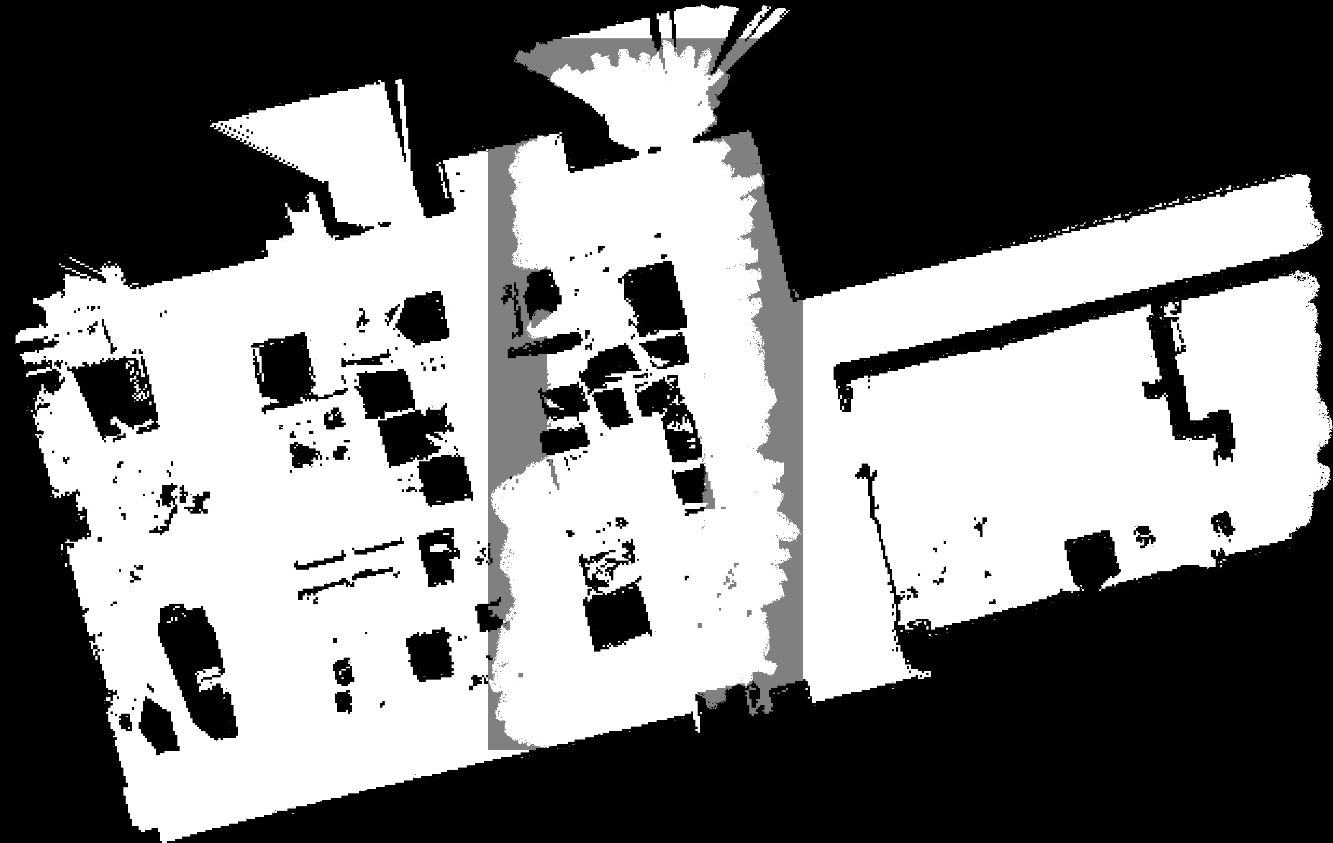
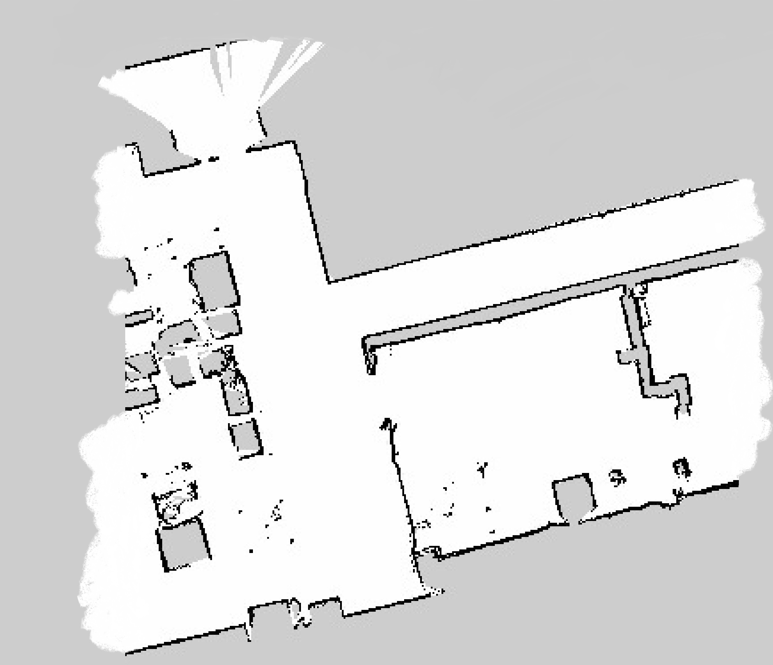
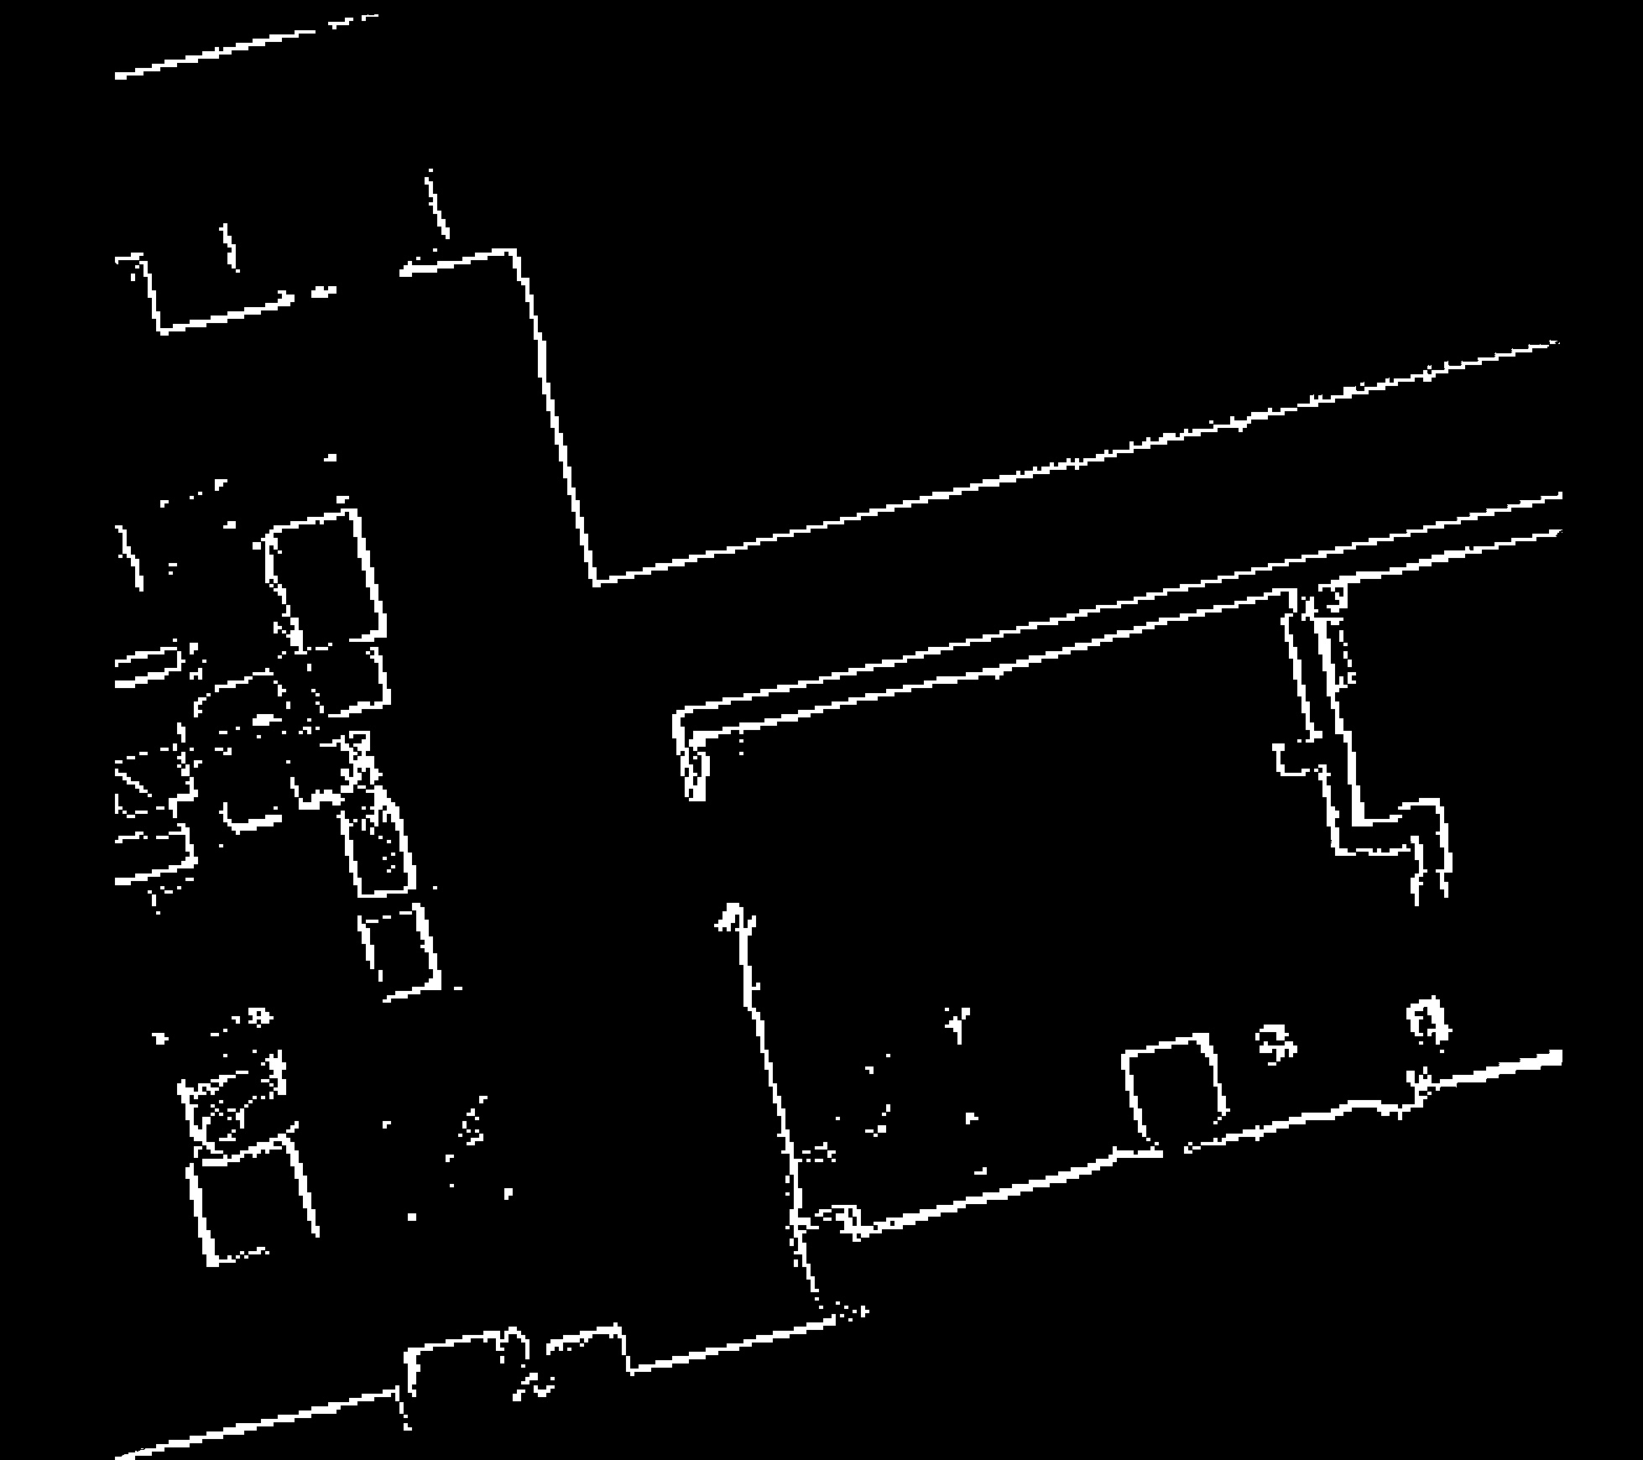
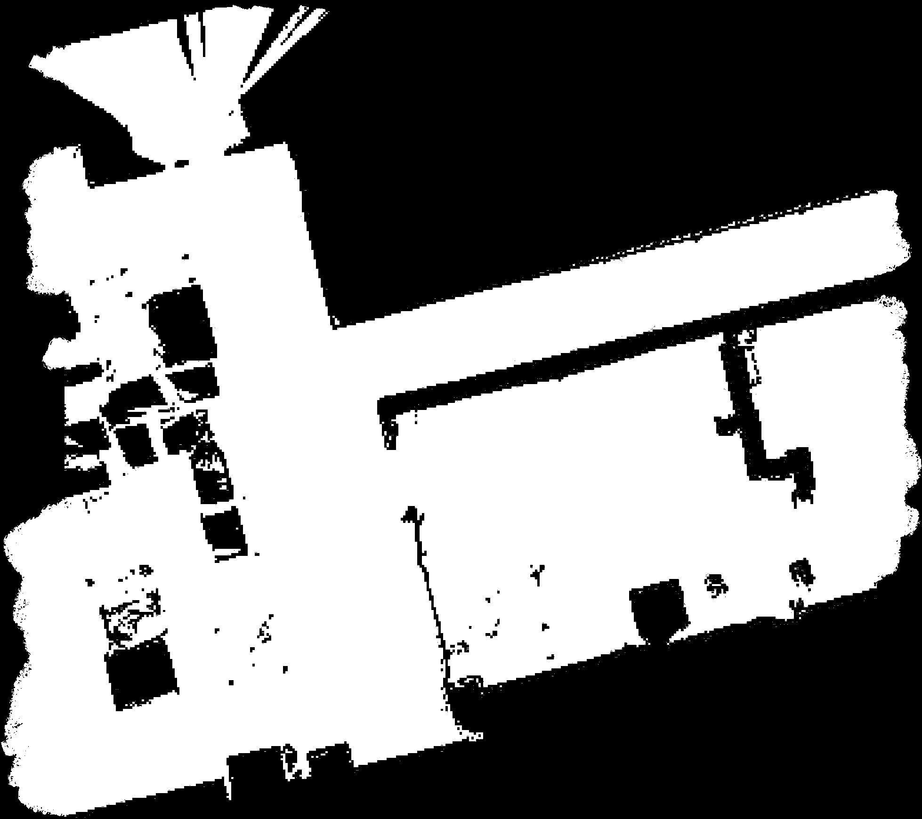
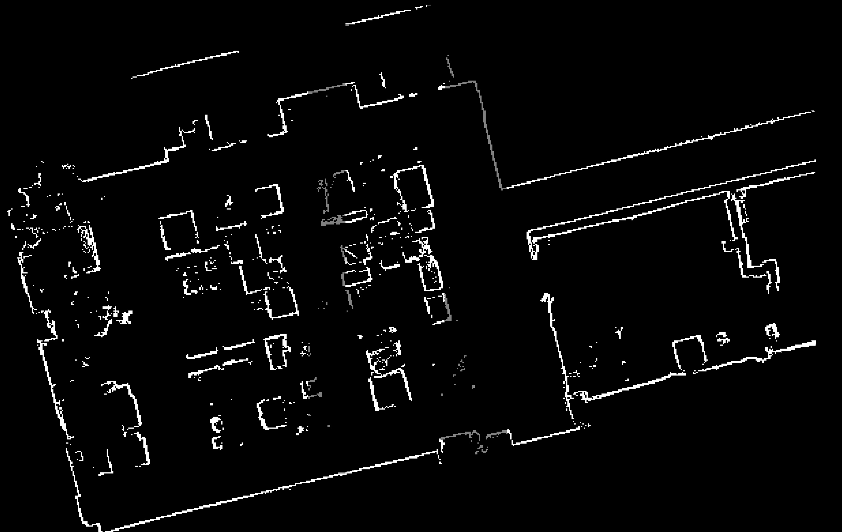
1. Replicating Functionalities
Map Merging Tool
Solution: Blending of Masks
Input Maps
Extract Masks (Black and White)
Blend Masks
Processing
Black Pixels
White Pixels
Blended White Mask
Black Pixels
White Pixels
Blended Black Mask
Notes:
The solution to this problem was to make use of the blending of masks, what I did was to extract two kinds of masks from each image, one to denote the position of black pixels and one to denote the position of white pixels. And then this is followed by the blending of masks after the transformation function was derived.

Slide 28
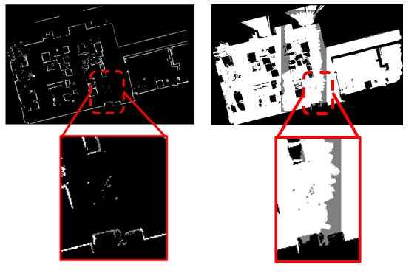
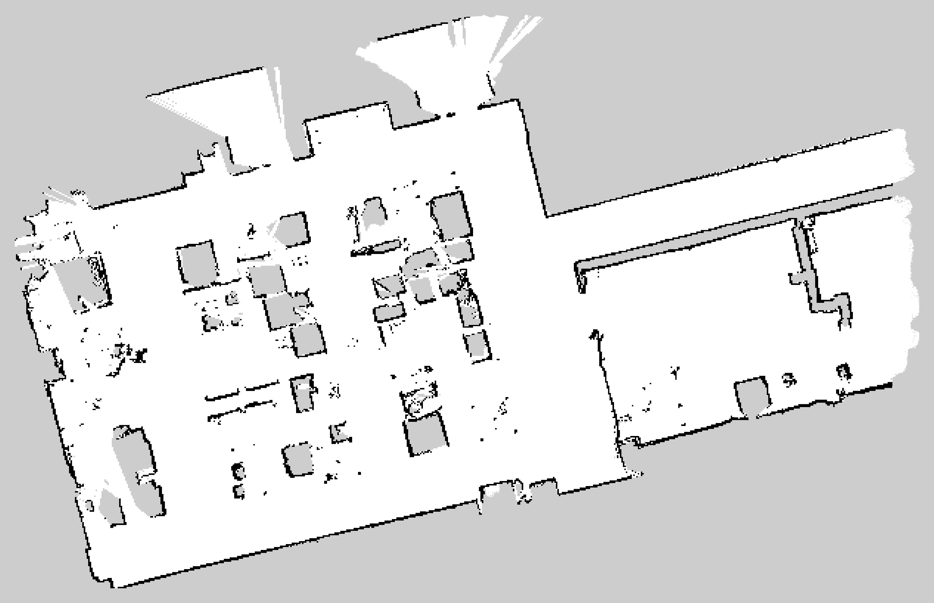
1. Replicating Functionalities
Map Merging Tool
Processing with Blended Masks
To overwrite the pixels in the final merged image
Pixels with non-zero values indicate the presence of colored pixels at that location
Overwrite with grey pixels → white pixels → black pixels
Figure 11. Final merged map after utilization of the blended masks
Figure 5. Zoom view of the blended regions; (Left) Black mask and (Right) white mask.
Notes:
With the two blended and merged masks, I am able to determine the exact location of the coloured pixels that the mask was responsible for, and overwrite the pixels in the final unprocessed merged image. When viewed in the form of a numerical matrix, pixels with non-zero values indicate the presence of a coloured pixel at that location.
Bringing your attention to the right figure, pixels still retain some colour or a value in the regions of overlap, this allows for the recovery of pixels despite the overlap earlier on. From this, I have determined the locations of the black and white pixels, all I needed to do was to overwrite the unprocessed merged image earlier on with grey pixels followed by white and then black. And this is the final processed image.

Slide 29
1. Replicating Functionalities
Map Merging Tool
Product of Phase: Pair-Map Stitcher
Limitations:
Images must be supplied in their true order
Only two images can be stitched per iteration
True-Left
True-Right
Notes:
Despite solving the problem of overlap, there are other limitations that were present but will be addressed later on in the map merging tool creation process. The two limitations are that the images must be supplied in their true order, and only two images can be stitched per iteration which makes it limited in its scalability and capability as a robust tool.

Slide 30
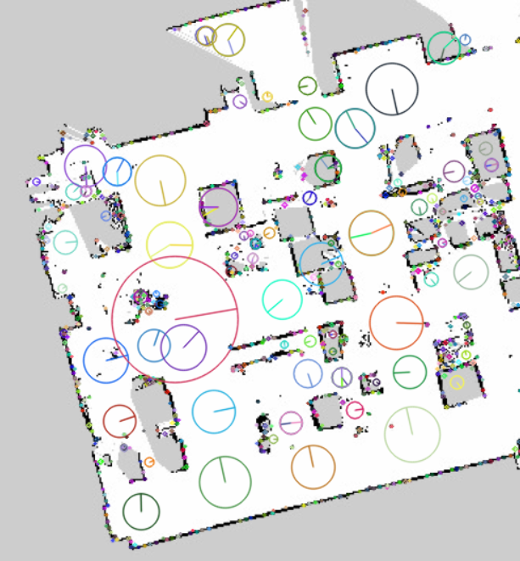
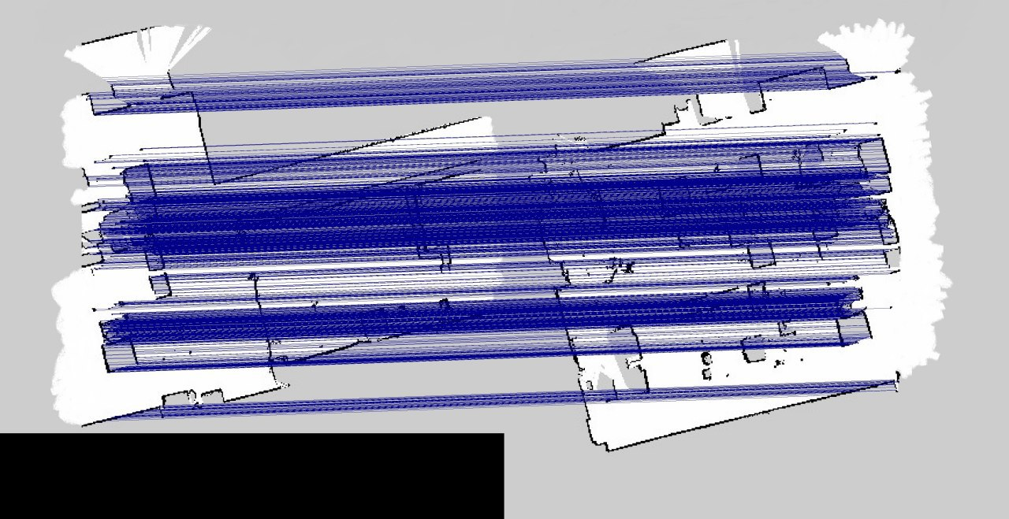
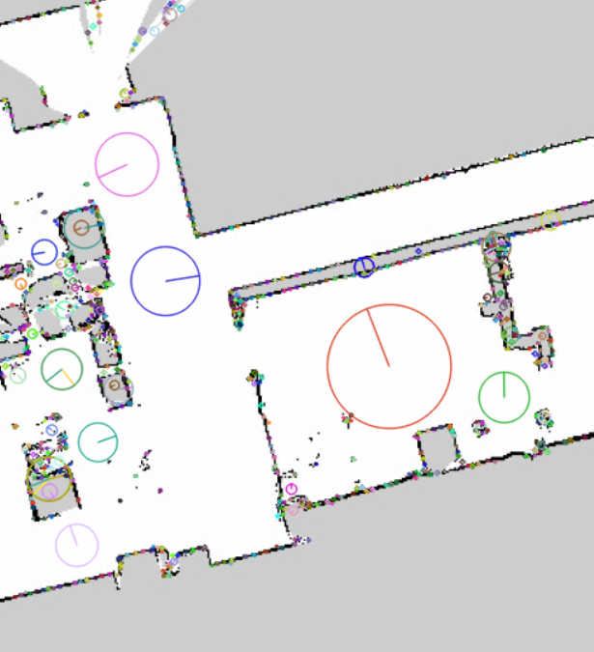
1. Replicating Functionalities
Map Merging Tool
Product of Phase: Pair-Map Stitcher
Input Overlapping Maps
Feature Detection Description + Matching
Estimate Transformation + Stitch
Notes:
Besides addressing the limitations later on, there was an opportunity for research here in the basic steps for putting images together. And the focus will be on the feature detection and description phase. This is mainly because of all the steps, this step was the only one that could be actively modified without affecting the rest of the steps, by switching which feature-detector-descriptor algorithm I would like to use for this iteration of stitch.

Slide 31
1. Replicating Functionalities
Map Merging Tool
Research Focus:
Feature Detection Description
Handcrafted Algorithms
Features generated are manually engineered by data scientists and researchers
SIFT – Scale-Invariant Feature Transform
SURF – Speed-Up Robust Features
ORB – Oriented Rotated BRIEF
BRISK – Binary Robust Invariant Scalable Keypoints
KAZE – translates to “wind” in Japanese
AKAZE – Accelerated KAZE
Learned Algorithms
Features are generated from a machine learning algorithm
SIFT-GeoDesc – Learning Local Descriptors by Integrating Geometrical Constraints
SIFT-ContextDesc – Local Descriptor Augmentation with Cross-Modality Context
Notes:
Focusing on this particular step, presents itself as an opportunity to evaluate the performance of various algorithms that have been created for the cause. And in recent times machine learning has entered this field of feature detection and description, and were shown to have remarkable improvements over the handcrafted variants in benchmark tests such as image matching and retrieval. Handcrafted algorithms produced features that are manually engineered while learned algorithms generate features from a neural network model.
Presented in these two blocks are the names of the algorithms that will be evaluated in the next phase of the map merging tool creation process.

Slide 32
1. Replicating Functionalities
Map Merging Tool
2. Evaluation Testing
Map Merging Tool
3. Proposed Solution
Map Merging Tool
4. Product Testing
Map Merging Tool
5. Product Discussion
Map Merging Tool

Slide 33
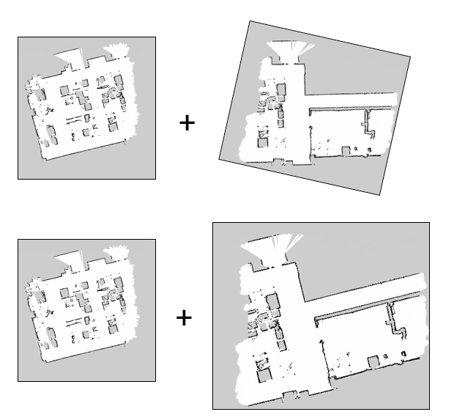
2. Evaluation Testing
Map Merging Tool
Evaluating Feature-Detector-Descriptors
Utilising the Pair-Map Stitcher Class
Test the performance of these algorithms with respect to differences in rotation and scale
To determine suitable algorithms for map merging
Looking for speed, stability, and high success rates
Figure 12. Illustration of application of synthetic transformation to mimic common differences between maps.
Notes:
The Pair-Map Stitcher class that was created in the previously will be used for the performance evaluation of the eight feature-detector-descriptor algorithms. And the performance of these algorithms will be tested with respect to differences in the rotation and scale between the images in the pair. These differences are what is commonly found between maps out there in actual scenarios, and this test attempts to replicate the intricacies of the maps produced. With reference to the right figure, transformation is manually applied to one of the images of the pair to introduce this difference.
From this test the main aim is to determine suitable algorithms for the map merging problem, and what I was looking out for were fast, stable and successful algorithms.

Slide 34
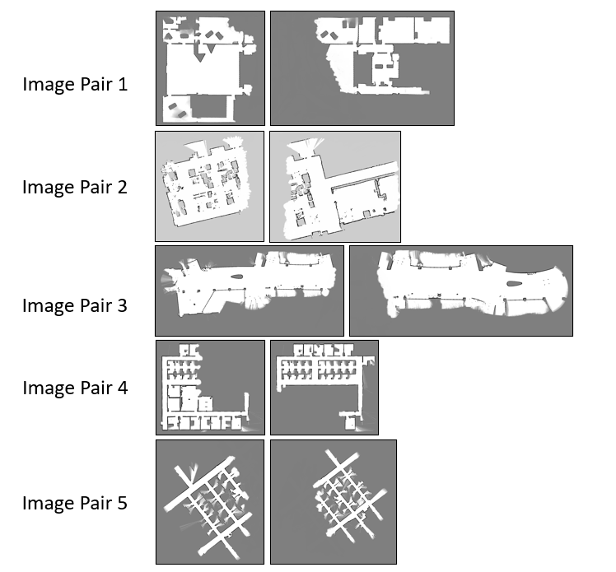
2. Evaluation Testing
Map Merging Tool
Dataset Acquisition
Extracted from the Robotics Dataset Repository (RADISH) provided by MIT University
Manually cropped and altered using Microsoft Paint
Each pair has its own special perceived characteristic that adds to the challenge
Dataset: 5 pairs of map images
Reference:
"Radish: Robotics Research Datasets", Dspace.mit.edu, 2022. [Online]. Available: https://dspace.mit.edu/handle/1721.1/62236.
Figure 13. Manually created test dataset.
Notes:
With a lack of a public benchmark dataset for the particular cause of stitching maps, a dataset was manually created by maps found in public repositories like RADISH and provided to me by Syncware. Using Microsoft paint, each map was cropped into two and manually altered to replicate partial maps found in the robotics field. The maps are as shown in the figure on the right.
Each pair has its own special perceived characteristic that adds to the challenge of the map merging process, and some of them include having a small amount of overlap, having very simple features, having repetitive features, having very large dimensions, so on and so forth.
With these 5 pairs of images, a test sequence was carried out

Slide 35
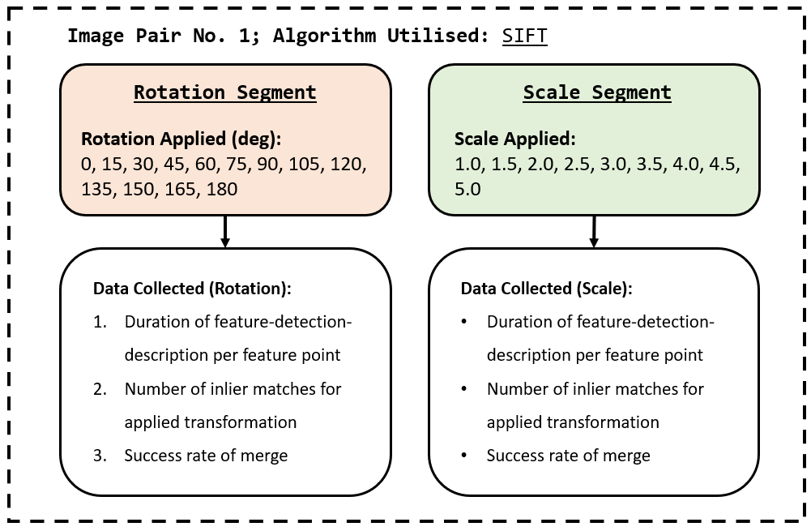
2. Evaluation Testing
Map Merging Tool
Test Sequence:
Figure 14. Evaluation test sequence and type of data collected for one image pair.
Notes:
This is how the test sequence will be executed. For each image pair, we will utilise all 8 of the FDD algorithms one at a time, that we selected for the merging process. In this figure, image pair no. 1 was the image pair to be merged, and the algorithm used was SIFT. For each algorithm utilised there is a rotation segment (click) and a scale segment (click) whereby we will apply the respective transformations in increments. Data is collected in each of these segments that will serve as performance key indicators for the evaluation. The three data collected are, the …

Slide 36
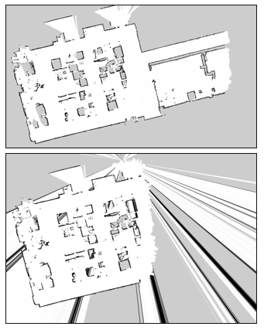
2. Evaluation Testing
Map Merging Tool
Performance Indicators:
Feature-detection-description timing per point
Assesses the computational efficiency of the FDD algorithm
Number of inlier matches against applied transformation
Assesses the stability and robustness of the features generated w.r.t rotation and scaling
Success Rate
Assesses the likelihood of a successful homography estimation
Figure 15. (Top) Example of a successful merge and (Bottom) a failed merge.
Notes:
These three performance indicators each have a purpose that will aid in the discovery of the suitable algorithm for the cause of map merging. For the feature-detection-description timing per point, this assesses the computational efficiency of the algorithm to detect and describe features. The faster the timing, the higher the computational efficiency. This becomes important when maps get substantially large, and computational resources are limited.
On the number of inlier matches against applied transformation, this assess that stability and robustness of the features generated w.r.t to the transformation applied. The idea here is that we want features to be describe in such a way that it can still retain its form regardless of the differences of the image as a whole. If the features of the transformed image manages to somehow remain the same, the number of matches should be stable and the features are considered to be stable.
The success rate assesses the likelihood of a successful homography estimation which is linked to the inlier matches that were found. Having a stable number of inlier matches does not mean that you have detected the correct matches, and as such, we would need to see the end product. As shown on the right, the top image denotes a successful merge while the bottom is a failed merge

Slide 37

Executing tests …
Notes:
And so after data collection and processing, here are the results

Slide 38
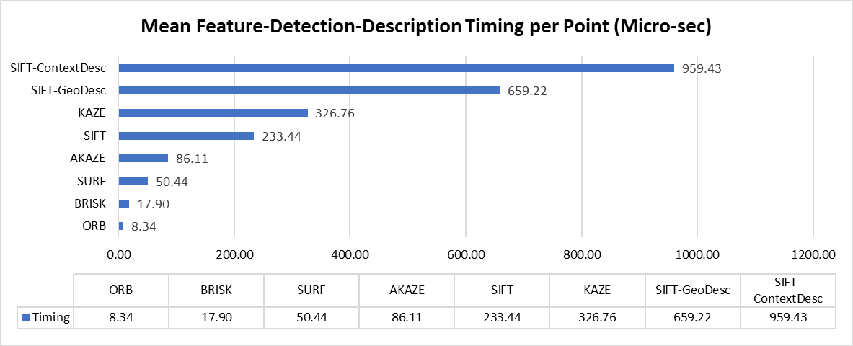
2. Evaluation Testing
Map Merging Tool
Observations: Feature-Detection-Description Timing per Point
ORB and BRISK consistently had the fastest timings across all image pairs due to its binary approach to the description
KAZE and SIFT-ContextDesc were the slowest of their respective variants
Figure 16. Sample of mean feature-detection-description timing per point for each algorithm for image pair 1.
Overall Speed Rank:
ORB > BRISK > SURF > AKAZE > SIFT > KAZE > SIFT-GeoDesc > SIFT-ContextDesc
Notes:
Starting with the timing. It was found that ORB and BRISK consistently had the fastest timings, which is due to their binary approach to the description of features.
KAZE and SIFT-ContextDesc were found to be the slowest of their respective variants, and handcrafted variants in general are faster than the learned variants.
The overall ranking starting with the fastest is ORB followed by BRISK, SURF, AKAZE, SIFT, KAZE, SIFT-GeoDesc and finally SIFT-ContextDesc

Slide 39
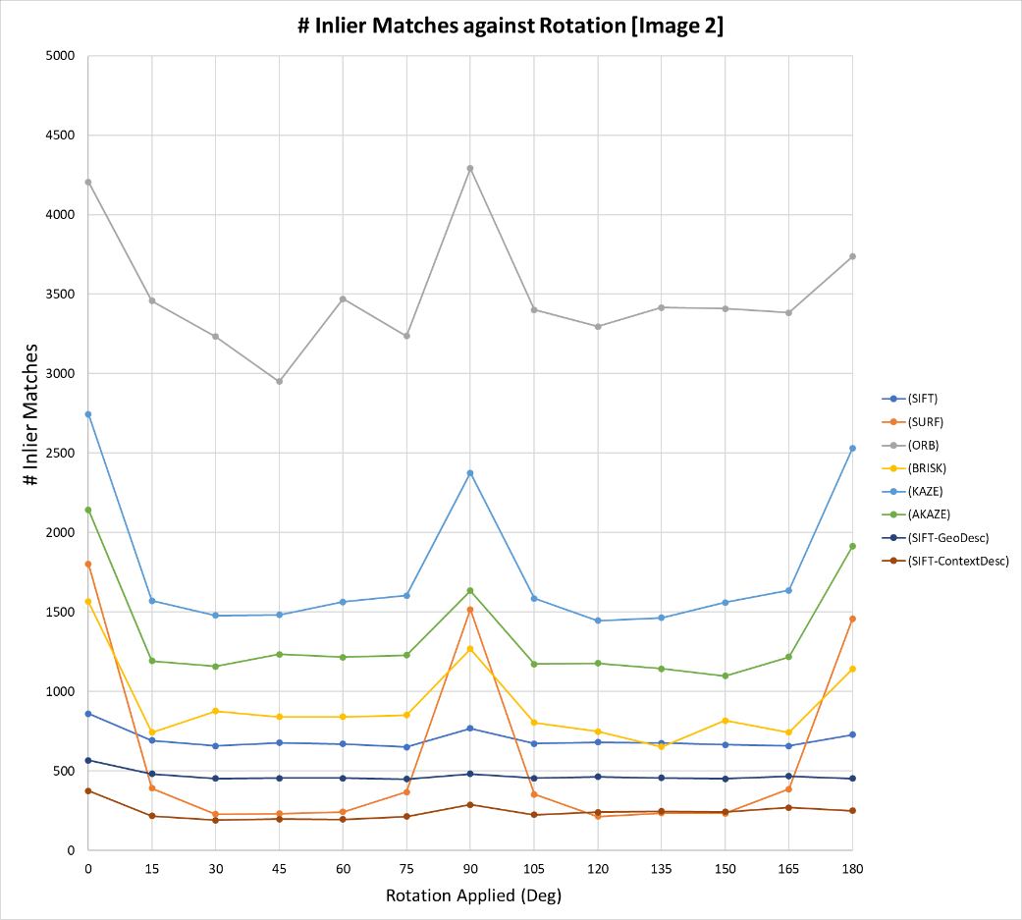
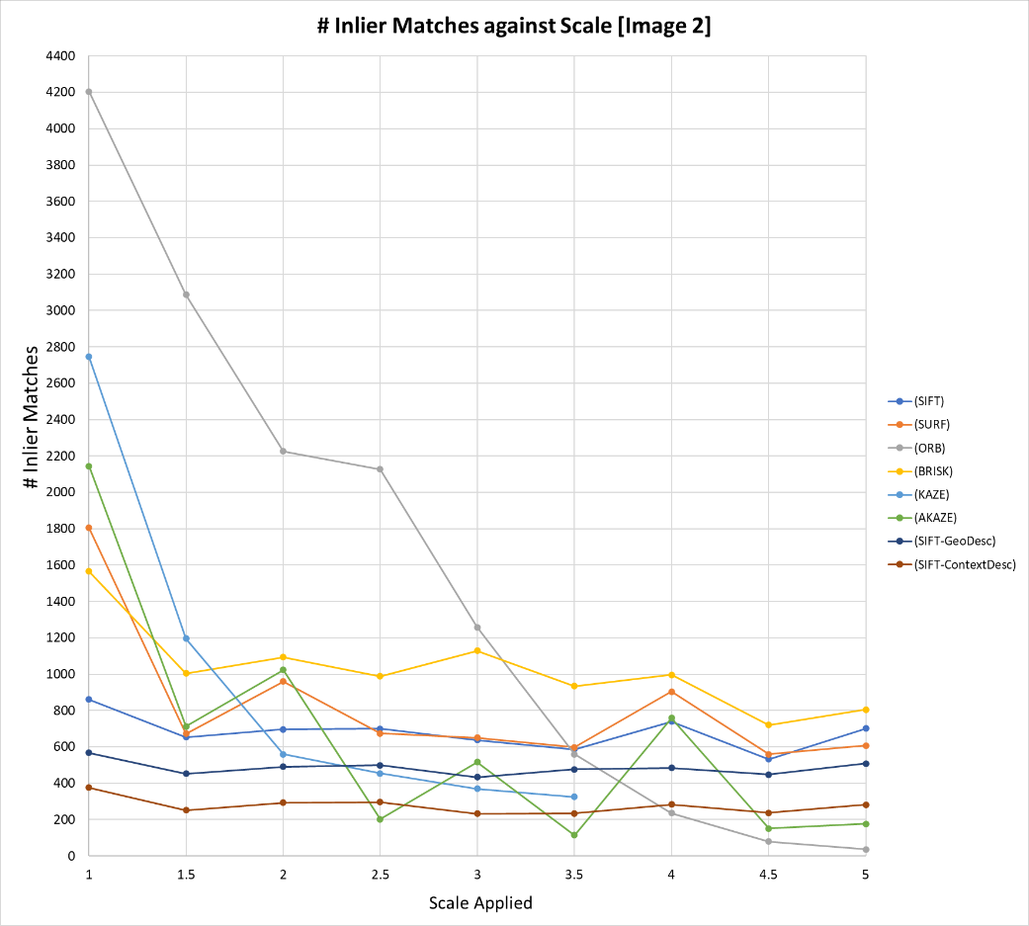
2. Evaluation Testing
Map Merging Tool
Observations: Number of Inlier Matches against Applied Transformation
Rotation Segment
Scale Segment
Figure 17. Sample of number of inlier matches against applied transformation (rotation and scaling) for each algorithm for image pair 2.
Notes:
Up next we have the number of inlier matches against applied rotation and scale. And here are how the data were presented. The number of inlier matches were plotted against the transformation applied for each of the 8 algorithms. However, despite some evidently obvious observations as shown in these graphs like peaks in inlier matches in the rotation segment or drops in the scale segment. Evaluation from observation can be erroneous especially when many plots cross each other.

Slide 40
2. Evaluation Testing
Map Merging Tool
Observations: STDEV Inlier Matches / Mean # Inlier Matches
Table 1. Inlier STDEV to Mean Inlier for each algorithm for Image Pair 1.
SIFT, SIFT-GeoDesc, and SIFT-ContextDesc were observed to have high occurrence of values < 0.25
Notes:
As such, a metric was devised. Which is the ratio of the STDEV of inlier matches to the mean number of inlier matches for the whole segment for a single algorithm. The table on the right shows the ratio values for each of the 8 algorithms in the two test segments for image pair 1. The idea is that the lower the value, the more invariant the features are to rotation and scaling. From the processing of data, and using a threshold value of 0.25, the only two algorithms that managed to obtained satisfactory values were SIFT and SIFT-GeoDesc for the merging of all pairs.

Slide 41
2. Evaluation Testing
Map Merging Tool
Observations: Success Rates
Only SIFT and SIFT-GeoDesc managed to successfully stitched all pairs regardless of applied transformation
Table 2. Success states for each algorithm at each rotation applied.
Table 3. Success states for each algorithm at each scale applied.
Notes:
For the last of the performance indicators, the success rates, SIFT and SIFT-GeoDesc managed to successful stitched all pairs regardless of the selected applied transformation.

Slide 42
2. Evaluation Testing
Map Merging Tool
Evaluation Conclusion
Handcrafted variants are more computationally efficient than the learned variants
SIFT, SIFT-GeoDesc, and SIFT-ContextDesc were perceived to produce the most rotation-invariant and scale-invariant features
SIFT and SIFT-GeoDesc were the most successful in merging
Caution: The test dataset may not be representative of the population; conclusion should not be taken as the final say
Notes:
With that the overall evaluation of the algorithms are as follows: Handcrafted variants are more computationally efficient than the learned variants. SIFT, SIFT-GeoDesc…..
From this, we would like inclined to say that SIFT and SIFT-GeoDesc would be the most suitable algorithms for merging of maps because a successful merged map is desirable in any case. However, one thing to note is that the test dataset is unlikely to accurately reflect actual scenarios due to its small sample size. As such, what was concluded here should stay within the boundaries of this test. Nonetheless, the evaluation has presented valuable information such as computational efficiencies between handcrafted and learned variants.

Slide 43
1. Replicating Functionalities
Map Merging Tool
2. Evaluation Testing
Map Merging Tool
3. Proposed Solution
Map Merging Tool
4. Product Testing
Map Merging Tool
5. Product Discussion
Map Merging Tool
Notes:
That is the end of the evaluation testing, the next phase is to finally come up with the actual product and address the limitations that were present in the first map merging tool that was created.

Slide 44
3. Proposed Solution
Map Merging Tool
Limitations of Pair-Map Stitcher:
Images must be supplied in their true order
Only two images can be stitched per iteration
Notes:
The limitations were that images need to be supplied in their true order, and that only two images can be stitched per iteration.

Slide 45
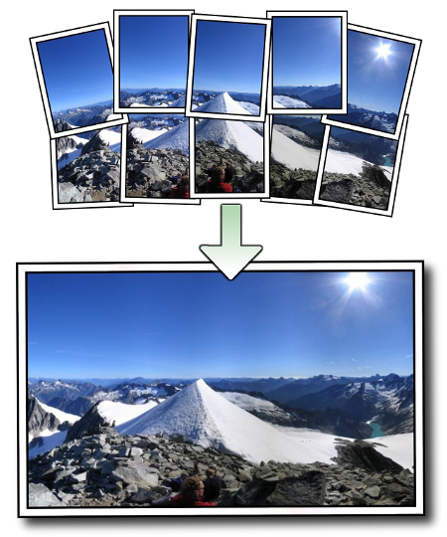
3. Proposed Solution
Map Merging Tool
Solution: Adoption of OpenCV’s Stitcher Class
Brown M. and Lowe D.’s “Automatic Panoramic Image Stitching using Invariant Features”
Able to stitch images regardless of the number of images and order of input
The pipeline was extracted and configured
Incorporate the 8 feature-detector-descriptor algorithms
Product: Multi-Map Stitcher Class
Figure 18. Demonstration of AutoStitch.
Notes:
In a bid to overcome this limitations, I chanced upon an open-source module that was provided by OpenCV an open-source computer vision library. The module is called Stitcher and it is an implementation of Mathew Brown and David Lowe’s automatic panoramic image stitcher tool called autostitch, and the class is able to stitch images regardless of the number of images and the order of input, what we were looking for in this phase. And as such the pipeline was extracted and tinkered with for the needs of the map merging tool.
The product is a multi-map stitcher class that succeeds the pair-map stitcher class

Slide 46
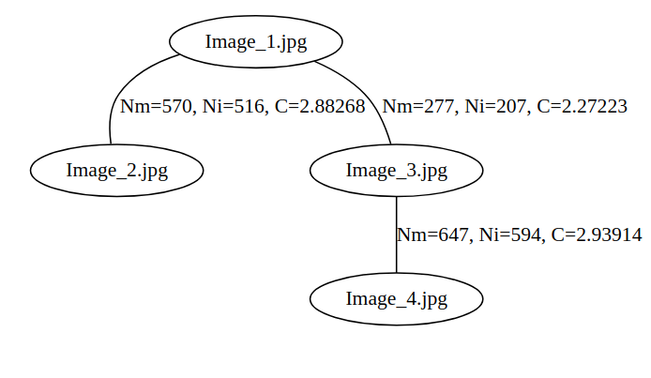
3. Proposed Solution
Map Merging Tool
Feature Detection & Description
Pairwise Matching
Finding Largest Component
Compute Homography between Pairs
Homography 1
Homography 2
Homography 3
Warp
Bundle Adjustment
Notes:
Here is a brief overview of the main steps that are taken by the class. Starting with the same feature detection and description step, followed by matching. However the difference now is that pairwise matching is executed due to the presence of multiple input images. Each image is matched to every other image in the supplied set of images.
This is then followed by finding the largest component, that is the subset of images that will take part in the final merge. This is important as there can potentially be independent maps with no overlaps.
The next step is to compute the homography between relative images in the largest component found, and execute bundle adjustment on it to optimise the camera parameters. This is done by minimizing the reprojection error between the image locations of observed and predicted image points. This step is crucial as a concatenation of relative homographies will cause an accumulation of errors.
The last step is to warp everything together into a global map.

Slide 47
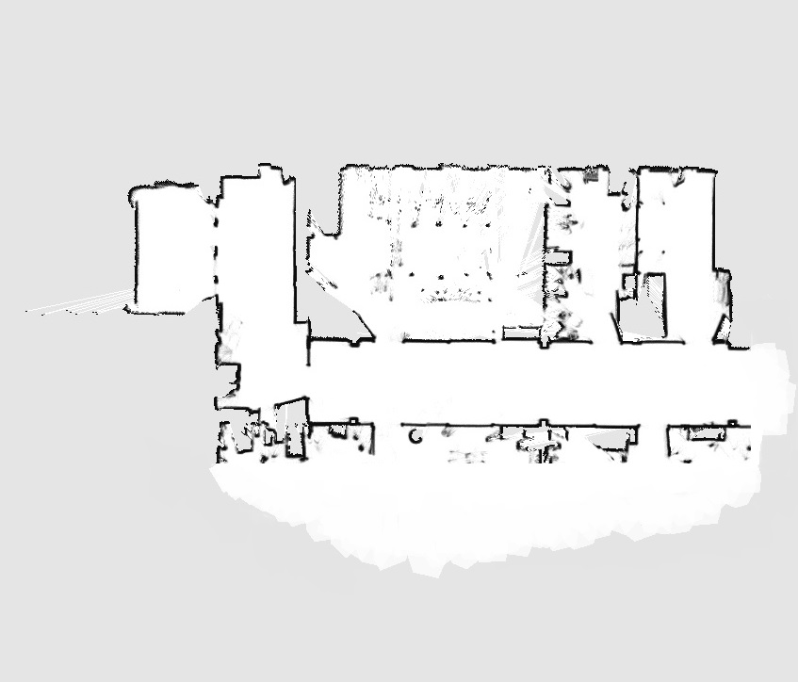
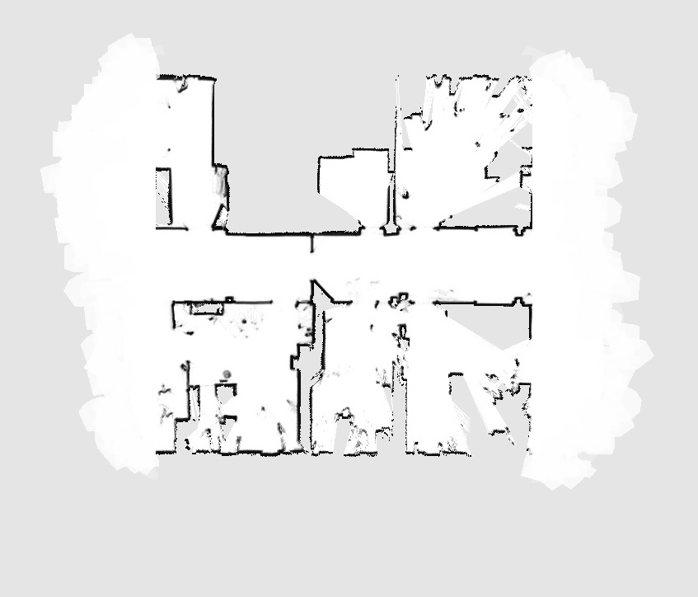
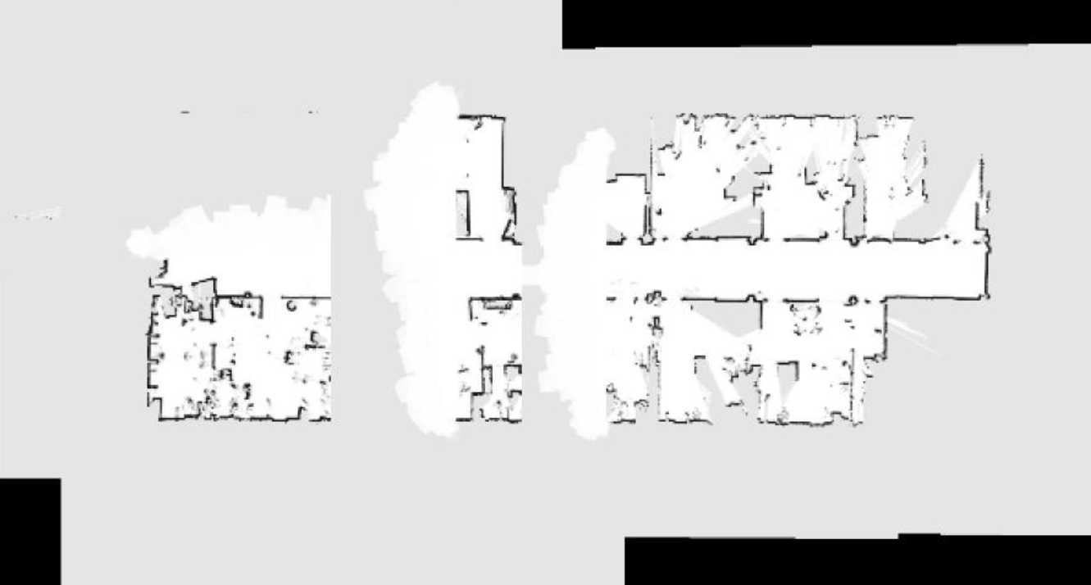
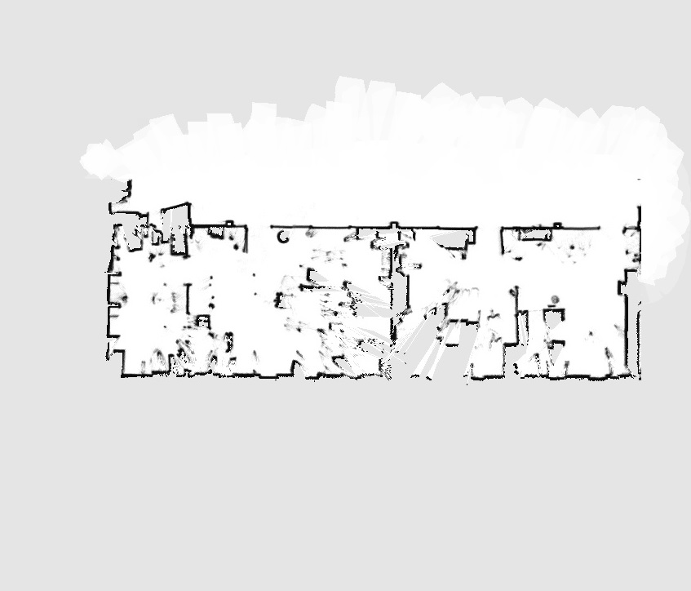
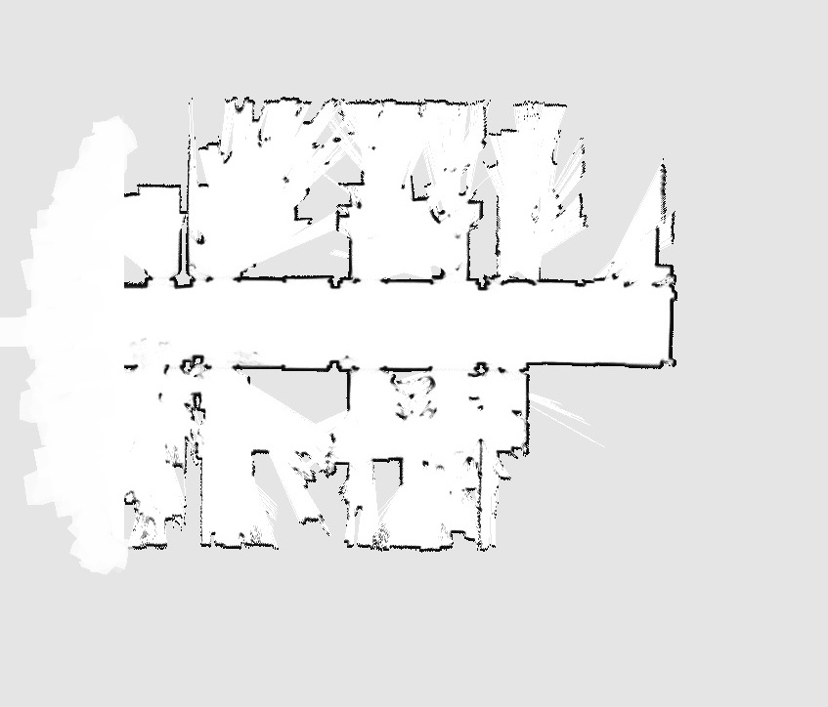
3. Proposed Solution
Map Merging Tool
Map retrieved from:
"Radish: Robotics Research Datasets", Dspace.mit.edu, 2022. [Online]. Available: https://dspace.mit.edu/handle/1721.1/62236.
Merged Map
Overlapping Maps
Notes:
Here is the multi-map stitcher in action, and here we see the same overlapping regions brought about by the approach to panorama stitching.

Slide 48
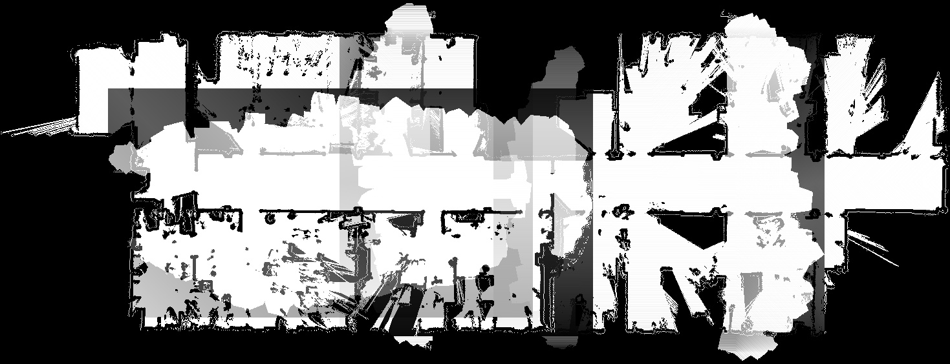
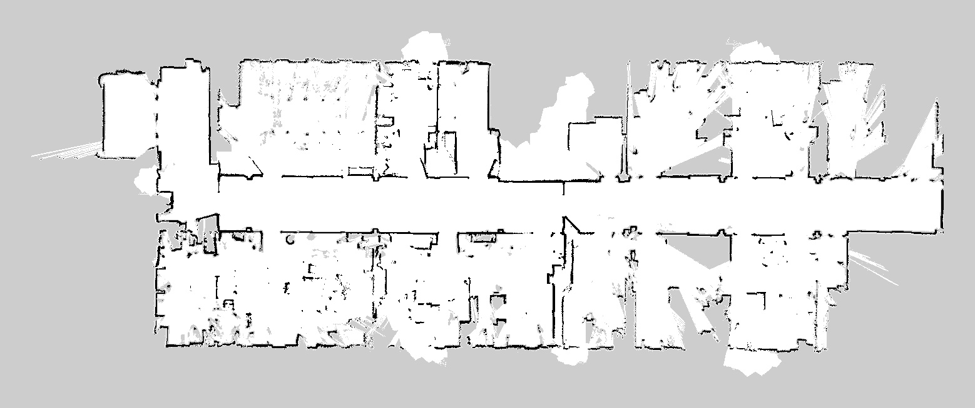

3. Proposed Solution
Map Merging Tool
✔
Processed Merged Map
Blending of Masks
Notes:
The same approach was to create the same blended masks to recover the pixels that were overlapped and overwrite the final image.

Slide 49
1. Replicating Functionalities
Map Merging Tool
2. Evaluation Testing
Map Merging Tool
3. Proposed Solution
Map Merging Tool
4. Product Testing
Map Merging Tool
5. Product Discussion
Map Merging Tool
Notes:
With that the product is ready for testing.

Slide 50

4. Product Testing
Map Merging Tool
Simulation Test
Warehouse world was extracted from AWS Github repository
The aim is to create multiple overlapping maps for merging
Product Used: Multi-Map Stitcher Class
Robot Used: Mobile Industrial Robots (MiR) MiR100
Figure 19. GIF of an MiR100 robot mapping in an Amazon Web Services (AWS) small warehouse world in Gazebo
Notes:
A simulation test was executed using a warehouse world provided by Amazon in an open-source repository. The aim was to create multiple overlapping maps for merging, and the robot used here was the MiR100 provided by Mobile Industrial Robots. The GIF on the right shows

Slide 51

4. Product Testing
Map Merging Tool
Figure 20. Modified Amazon Web Services (AWS) small warehouse world with additional open-source models by Gazebo
Notes:
However, due to the long range LIDAR capabilities of the MiR100 robot, a much larger warehouse was created by cloning the same amazon warehouse. In addition to that, new objects such as pallet movers and a crane were added from the Gazebo library.

Slide 52





4. Product Testing
Map Merging Tool
Algorithm Utilised: SIFT
✔
Merged Map
Input Maps
Notes:
Four overlapping partial maps were created and merged together to form one whole map that was observed to be close to ground truth.
The algorithm used here was SIFT

Slide 53
4. Product Testing
Map Merging Tool
Observations
SIFT-ContextDesc was the only algorithm to produce a failed merge
Most likely due to low number of matches found
Table 4. Comparison of number of matches, inlier matches, confidence and success (SIFT-ContextDesc).
Table 5. Comparison of number of matches, inlier matches, confidence and success (SURF).
Notes:
From the incorporation of the 8 algorithms, the only algorithm that failed the merge was SIFT-ContextDesc. This is most likely due to the detection of a very low number of matches found that led to an increased likelihood of a generation of a nonoptimal transformation function. Referring to the table at the bottom, we can see that SURF detected a much larger number of matches which led to a successful merge.

Slide 54

4. Product Testing
Map Merging Tool
Figure 21. Failed merge of the four partial overlapping maps by SIFT-ContextDesc.
Notes:
And this is how the failed merge looked like.

Slide 55
1. Replicating Functionalities
Map Merging Tool
2. Evaluation Testing
Map Merging Tool
3. Proposed Solution
Map Merging Tool
4. Product Testing
Map Merging Tool
5. Product Discussion
Map Merging Tool
Notes:
And that’s all for the testing of the multi-stitcher class

Slide 56

5. Product Discussion
Map Merging Tool
Product Conclusion
Created a map merging tool that is able to stitch partial overlapping maps regardless of quantity and order
Gave the option for users to test out multiple feature- detection-description algorithms
Recommended Further Improvements
To have a repeating execution of the program due to uncertainty of the amount of overlap needed
Combinations of 3D and 2D map merging to create a better representation of the environment
Multi-Map Stitcher
SIFT, SURF, ORB, BRISK, KAZE, AKAZE, SIFT-GeoDesc, SIFT-ContextDesc
Multi-Map Stitcher
Notes:
All in all, a map merging tool was created and was shown to be capable of stitching multiple partial overlapping maps regardless of the quantity and order of input. The incorporation of several feature-detector-descriptor algorithms also gives users an option of a multi-pronged to tackle the map merging problem.
For future improvements, I would like to suggest making the multi-stitcher class to execute repeatedly as the mapping process is being executed. This is because users will very likely be uncertain of the amount of overlap required for each map, and different environments will most likely have different levels of features which changes the minimum amount of overlap required for a good stitch. Furthermore, this deliverable focuses on the merging of 2-dimensional maps, it will be good to move towards 3-dimensional maps and combine them together to have a better representation of the environment (SAR)

Slide 57
Project Deliverables
Communication Bridge
Map Merging Tool
Notes:
With that, the two project deliverables and their methodologies have been presented.

Slide 58
Project Conclusion
Notes:
Moving on to the project conclusion.

Slide 59
Project Conclusion
Created a map merging tool that is able to stitch partial overlapping maps regardless of quantity and order
Communication Bridge
Map Merging Tool
Created a dual-component communication bridge formulated to be robust to different communication protocols
Created a map merging tool that is able to merge maps regardless of the number and order of inputs
Incorporation of the 8 feature-detector-descriptor algorithms provide a multi-pronged approach to merging maps
Notes:
All in all two items were created for the deliverables of this FYP. The communication bridge was created in an attempt to bridge the gap in communication incompatibility, and it was created to be robust to different communication protocols. The communication bridge came in the form of a dual-component structure which reduced the need for extensive modifications when faced with a different protocol.
On the other hand, the map merging tool was created as a value-adding utility for the Syncware Platform, and was tested to be able to maps regardless of the quantity and the order of input. The special feature of this tool is that it incorporates the 8 algorithms for the users to utilise and have an option of a multi-pronged approach to tackling the map merging problem.

Slide 60
🎉
End of Presentation

Slide 61
🔍
Questions & Answers

Slide 62
References
[1]: "2021 Warehouse/DC Operations Survey: Automation as a Disruption Response", Logisticsmgmt.com, 2021. [Online]. Available: https://www.logisticsmgmt.com/article/2021_warehouse_dc_operations_survey_automation_as_a_disruption_respo nse.
[2]: "Syncware.ai - Middleware software for warehouse robotics", Syncware.ai, 2022. [Online]. Available: https://www.syncware.ai/. [Accessed: 06- Jan- 2022].
[3]: S. Tareen and Z. Saleem, "A comparative analysis of SIFT, SURF, KAZE, AKAZE, ORB, and BRISK", 2018 International Conference on Computing, Mathematics and Engineering Technologies (iCoMET), 2018. Available: 10.1109/icomet.2018.8346440.
[4]: Z. Luo et al., "GeoDesc: Learning Local Descriptors by Integrating Geometry Constraints", Computer Vision – ECCV 2018, pp. 170-185, 2018. Available: 10.1007/978-3-030-01240-3_11.
[5]: Z. Luo et al., "ContextDesc: Local Descriptor Augmentation With Cross-Modality Context", 2019 IEEE/CVF Conference on Computer Vision and Pattern Recognition (CVPR), 2019. Available: 10.1109/cvpr.2019.00263.
[6]: Z. Luo et al., "ASLFeat: Learning Local Features of Accurate Shape and Localization", 2020 IEEE/CVF Conference on Computer Vision and Pattern Recognition (CVPR), 2020. Available: 10.1109/cvpr42600.2020.00662.
[7]: (CVPR), 2017. Available: 10.1109/cvpr.2017.736. J. Schonberger, H. Hardmeier, T. Sattler and M. Pollefeys, "Comparative Evaluation of Hand-Crafted and Learned Local Features", 2017 IEEE Conference on Computer Vision and Pattern Recognition
[8]: Sebahattin, Topal & Erkmen, Ismet & Erkmen, Aydan. (2010). A Novel Map Merging Methodology for Multi- Robot Systems. Lecture Notes in Engineering and Computer Science. 2186.
[9]: M. Brown and D. Lowe, "Automatic Panoramic Image Stitching using Invariant Features", International Journal of Computer Vision, vol. 74, no. 1, pp. 59-73, 2006. Available: 10.1007/s11263-006-0002-3

Slide 63
Appendices

Slide 64

⭐

Slide 65


Map Merging Tool
Map merge failed, repeating merge …

Slide 66






Take an area in Image Pair 1 as an example to illustrate the level of distortions despite recommended interpolation.
135 deg
Very similar to 0 deg
180 deg
Jagged textures not found in the original image
Jagged textures not found in the original image
0 deg
Original Image
45 deg
90 deg
Jagged textures not found in the original image
Very similar to 0 deg

Slide 67

SIFT-ContextDesc

Slide 68

A comparative analysis of SIFT, SURF, KAZE, AKAZE, ORB, and BRISK

Slide 69



Slide 70
Real-World
Simulated

Slide 71


